Slide 1
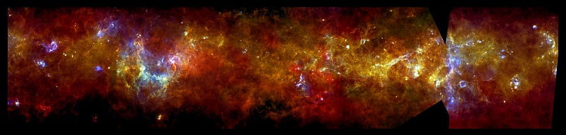



Far-Infrared Spectroscopic Explorer
- FIRSPEX -
D. Rigopoulou & J-S. Huang
Y. Gao, S-C. Shi
B. Swinyard, B. Ellison, T. Lim
Notes:
Thank you, a big thank you also to the organisers for inviting my team to make a presentation and to our local host for providing an excellent environment for furthering of scientific collaborations. I will present our concept for a mission to carry out an all sky survey and pointed observation in 5 discreet far-infrared spectroscopiuc bands

Slide 2
FIRSPEX Team
E. Caux (IRAP, FR) S. Molinari (IAPS-INAF, IT)
P. Caselli (Leeds, UK) M. Huang (NAOC, China)
M. Gerin (Obs. Paris, FR) L. Spinoglio (INAF, IT)
S. Madden (CEA/Saclay, FR) W. Zhong (NAOC, China)
P.F. Goldsmith (JPL, US) M.J. Griffin (Cardiff, UK) G.J. White (OU/RAL, UK) D. Li (NAOC, China)
J. R. Gao (SRON, NL) M. Wiedner (Obs. Paris, FR)
L. Hao (Shanghai, China) J. Yang (PMO, China)
C.N. Hao (Tianjin,NU, China) X.Y. Xia (Tianjin,NU, China)
F. Helmich (SRON, NL) G. Yassin (Oxford, UK)

Slide 3
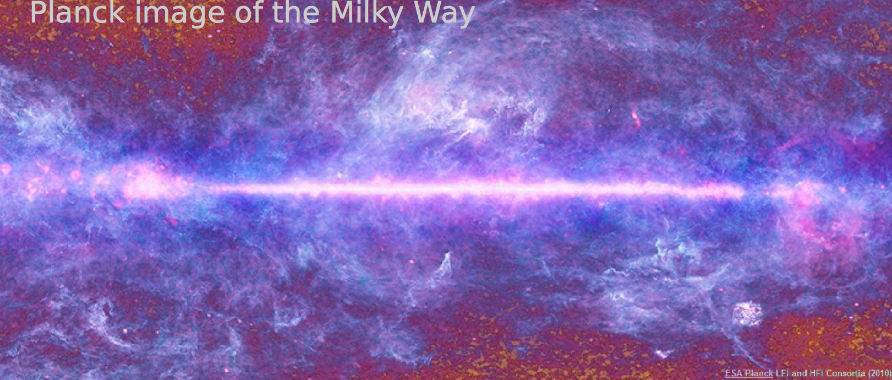
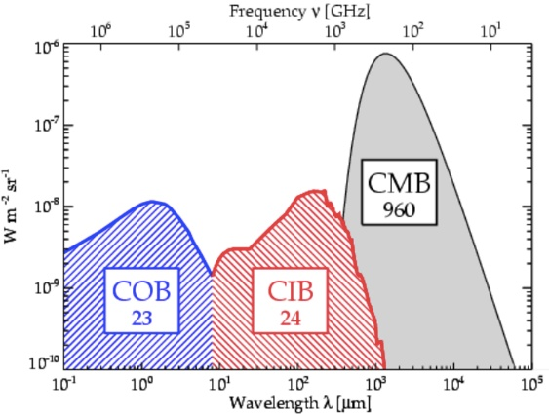
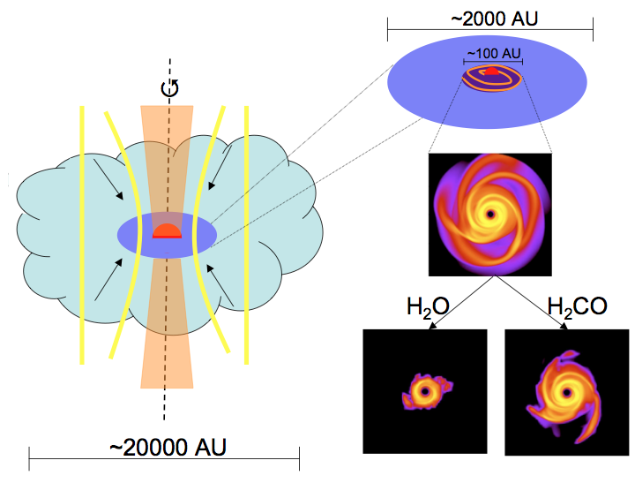
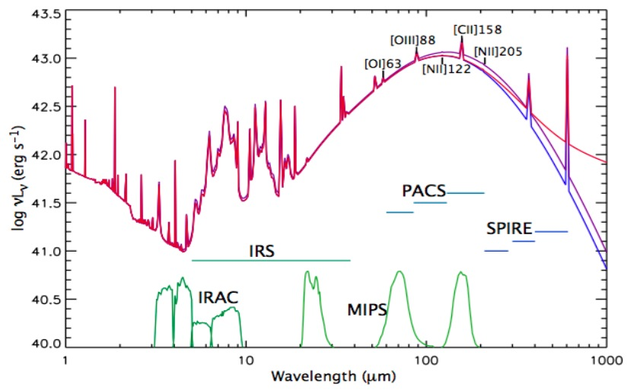
Why far-infrared?
Cosmic Infrared Background
The dawn of protoplanetary disks
Study the ISM
Early stages of star formation
Cooling processes in galaxies
Formation of complex molecules
Gas Grain chemistry
Notes:
Infrared Astronomy is ``younger’’ than other astronomical disciplines however, great strides have taken place in the last 30 years (since IRAS flew in 1985). Mention previous balloon missions. It is now well established that the cosmic infrared background is at least as strong as the optical one. Another area that benefits from studies in the infrared is that of the early stages of star formation. In spectroscopy the FIR is host to a series of important lines known as cooling lines that provide invaluable insight into the complex physical processes that take place in the ISM MENTION THE ESA KEY THEMES

Slide 4
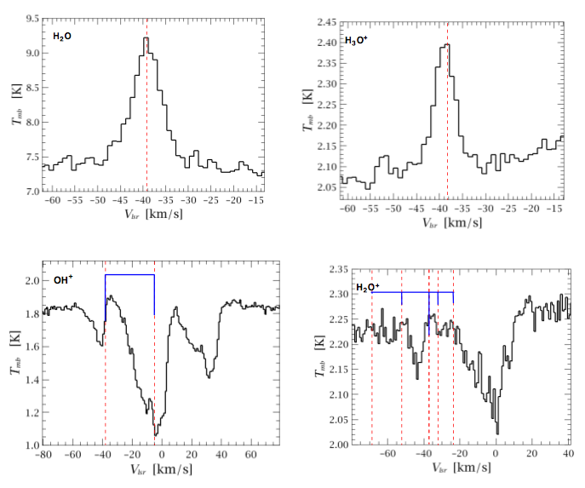
Herschel Heritage
Mrk231 (Gonzalez-Alfonso et al. 2011)
The WISH project (Kristensen et al. 2012
GOT C⁺ team (Pineda et al. (2013)
Notes:
The recent advent of the Herschel mission demonstrated the immense power of FIR spectroscopy in disentagling the role of atomic, molecular and ionic gas in our Galaxy and external galaxies. However, we only seem to have scratched the tip of the iceberg…. Spectroscopic observations on Herschel cover 1% of sky

Slide 5
But no spectroscopic equivalent to the
Herschel continuum survey of the Galactic Plane
Credit: ESA/Herschel, Hi-GAL survey (S. Molinari)
The Herschel infrared Galactic Plane Survey (Hi-GAL)
PI: S. Molinari
Notes:
Thanks to the superb imaging capabilities of Herschel SPIRE+PACS we now have a panoramic view of the galactic plane and can answer many important questions:
how much dust is there in the Galaxy, and what fraction of the overall galactic mass does this represent?
How do the proportions of dust to gas vary throughout the Galaxy?
How efficiently do stars form in different parts of the Galaxy?
How similar is our Galaxy to others in terms of star formation?

Slide 6
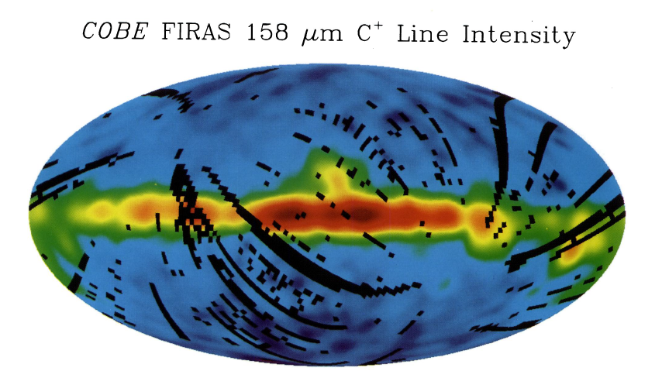
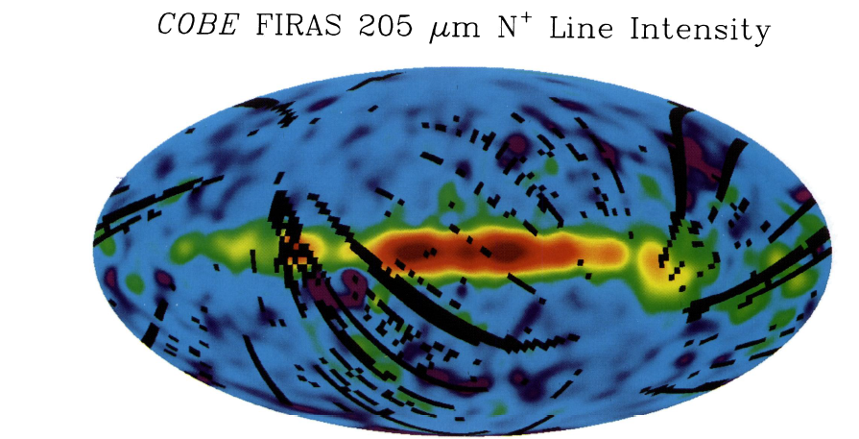
Heritage
COBE/FIRAS low resolution map in [CII],[NII] Bennett et al ’94
probe the CNM (Bennet et al 94), WIM (Heiles et al 94)
PDRs (Cubick et al. 08)
Spatial resolution 7°
Spectral res: 1000 km/sec
Notes:
The FIRAS instrument on COBE conducted a low resolution (spectral/angular) mapping of the [CII] in our Galaxy aiming to disentangle contributions from the cold neutral vs warm matetial and PDR (ie neutral vs ionized)
They found that in the Galactic plane the [CII] and [NII] distributions were similar but the intensities are different. C+ arises from cold neutral medium whereas NII from warm ionized medium. Studying these important cooling lines can help us disentagle the phases of the ISM. At high galactic latitude the C+ emission fall faster than IR indicating that the high galactic latitute fir emissio n has a different origin.

Slide 7
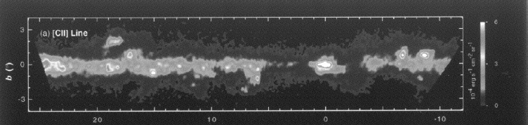
Balloon-borne Infrared [CII] Explorer (BICE)
Galactic Longitude in degrees
angular resolution: 15 arcmin
spectral resolution : 175 km/sec
Nakagawa et al. (1998)
Notes:
Subsequent ballon born missions line BICE but again limited survey and resolution

Slide 8
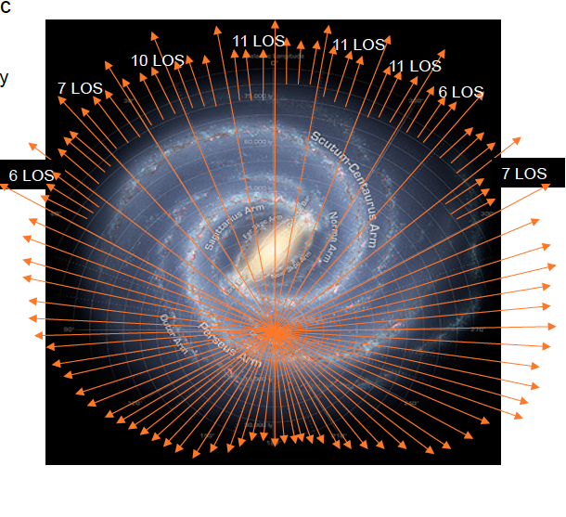
The Herschel-HIFI survey of [CII] in the Galaxy
(the GOT C⁺ team)
Galactic Plane and Galactic Central Regions Survey
[CII] emission in the Galaxy mostly
related to spiral arms, tracing clouds
transiting from atomic to molecular.
But to fully trace properties of ISM
we need large scale [CII] , [NII], [OI]
maps of the Galaxy and Nearby Galaxies
FIRSPEX survey
GOT C⁺ team (Pineda et al. (2013)
Notes:
More recently the HIFI carried out a survey of [CII] in the Galaxy The Galactic Observations of Terahertz C+: – Galactic Plane, looked at various LOS :
CII important for understanding the life cycle of ISM
Velocity-resolved observations of [C ii] are the most powerful technique available to disentangle the emission produced by
these components. These observations can also be used to trace CO-dark H2 gas and determine the total mass of the ISM.
Methods. The Galactic Observations of Terahertz C+ (GOTC+) project surveys the [C ii] 158 μm line over the entire Galactic

Slide 9
Far-Infrared Spectroscopic Explorer (FIRSPEX)
A proposed ESA-CAS mission to perform an all-sky survey and targeted observations in:
(OI) 63μm, OH 119μm, [CII] 158μm, H₂O 179.531µm [NII] 205μm
4.75 THz 2.51 THz 1.90 Thz 1.67 THz 1.46 THz
Top level Science Goal: Perform ``all-sky’’ survey
(equivalent of the IRAS/AKARI mission) in order to:
trace the transition from atomic to molecular clouds
investigate the formation of stars within high density regions,
understand the radiative feedback from newly formed stars and AGN
explore the termination of star formation

Slide 10
The choice of spectral lines
[OI] (63μm), [CII] (158 μm), [NII] (205 μm) Cooling mechanism in galactic and extragalactic environs
properties of Interstellar Medium (ISM) and its
microphysics
H₂O (179 μm)
important for the formation of complex molecules on ices. Controls gas/grain chemistry.
OH (119 μm)
Star forming regions in the Galaxy AGN feedback

Slide 11
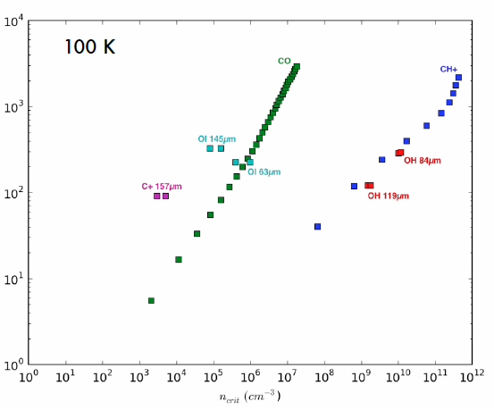
The choice of spectral lines
C+, OI major coolants
CH+ and OH key
molecules in PDRs
OH also traces the warm
and dense phase of the ISM
(high η_{crit} )
Eu (K)
η_{crit} (cm⁻³)

Slide 12
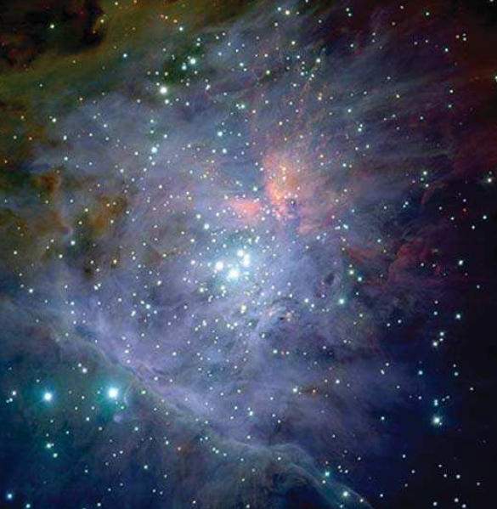
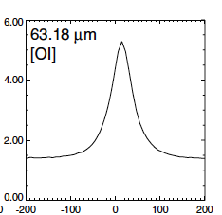
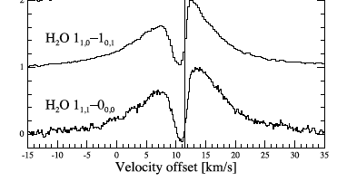
Physical conditions in Star forming regions
[OI] in Orion -KL
ISO-LWS
Lerate et al. 2006
Resolution
is key ….
Water in Orion-KL
HIFI
Kama et al. 2013
Notes:
Two points point to make
What are the characteristics of the new mission?
Resolution is key….
And of course sensitivity

Slide 13
Payload
Small mission provides excellent science opportunity.
Limited payload resources – low power, low mass, and small volume.
Cryogenic cooling to 4K too demanding with present technology, but ~20-50 K is viable.
Semiconductor (Schottky) mixer technology compliant with higher ambient temperature operation
Schottky offers good sensitivity and wide IF bandwidth.
Quantum Cascade Laser (QCL) Technology provides sufficient mixer LO power.
Proposed concept has the advantage of low cost cooling and relatively rapid mission deployment
Notes:
When thinking about FIR spectroscopy from space the choice is superconducting receivers
Given that a spacecraft in the small mission category use of 4K cooling systems is prohibitive. We therefore propose to use an alternative and well known detection technology that relies on semiconductor (Scottky) diode mixing which has the distinct advantage of higher ambient temperature operation, typically ~20K for best sensitivity.
Although NOT as sensitivite as superconducting receivers still ecellent sensitivity and S/N.
Noise Temp: 4000K at 1.5 THz , 1MHz. / 50,000K at 4.7K (assuming cooling down to 40-50K)
QCLs have been demonstrated tp provide 5mW continuous power at 40K. This value can go up to 10mW expectation and higher temp

Slide 14
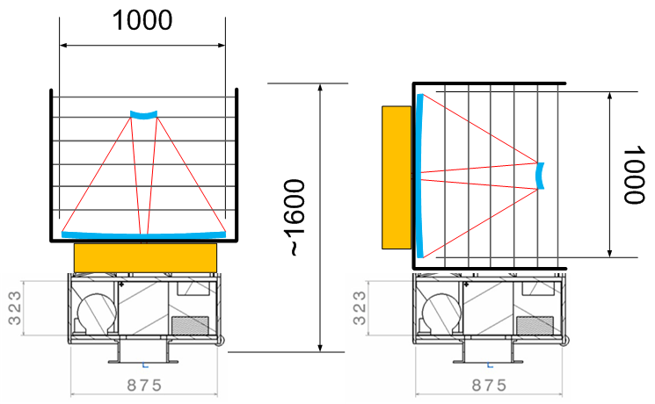
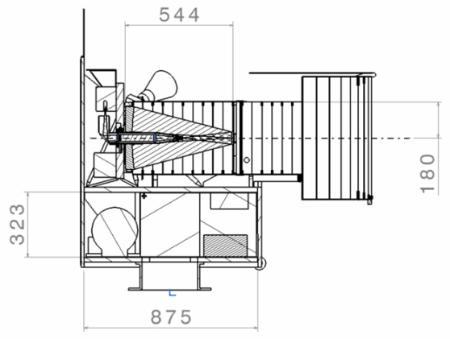
System Overview
Start from SSTL concept for CHEOPS
(35 cm optical telescope)
Mass (S/C + payload) ~ 200 kg
Take this “bus” and add 1m fast FIR telescope in tube
Mass ~250-300 kg (S/C + payload) assuming SiC mirror @25 kg/m²
Lighter weight CFRP telescope possible?
Notes:
Surrey Satelite Technology limited
Borrow concept of Cheops. Assume same bus and fast 1m FIR telescope FAST=low focal ratio -number telescope, can get away because we have big effective beams, aberations don’t matter
SiC: silicon carbide mirror : Herschel or Carbon Fiber Reinforced Polymers ?

Slide 15
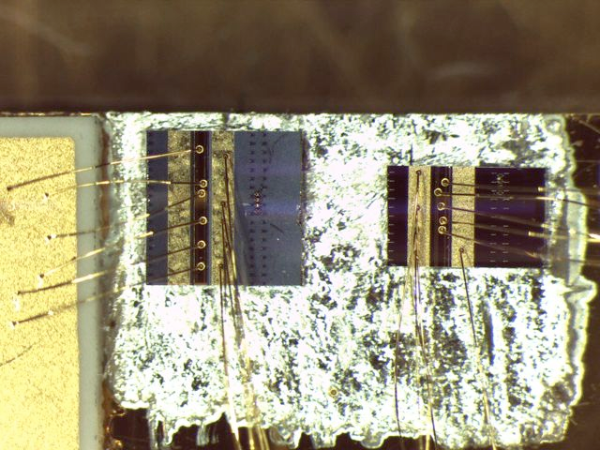
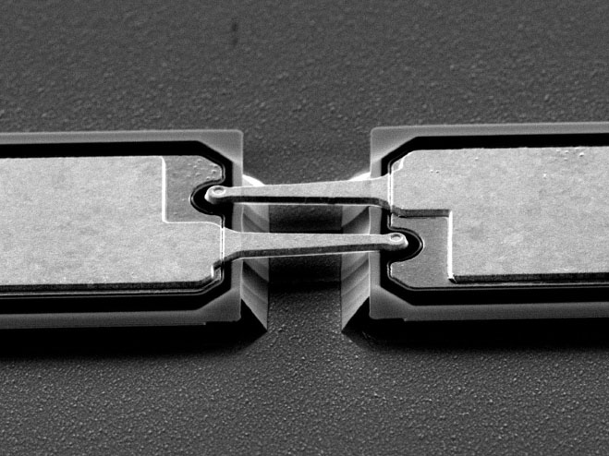
QCL FIR Laser device developed at Leeds University
Planar Schottky mixer diode
developed at RAL-Space
Exploring alternatives in collaboration with Purple Mountain Observatory colleagues
Notes:
To repeat Prof. Zarnecki’s statements when phased with a new mission we should try something that hasn’t been tried before….
But not necessarily ``expensive’’ mission…

Slide 16
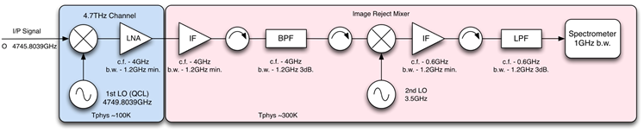
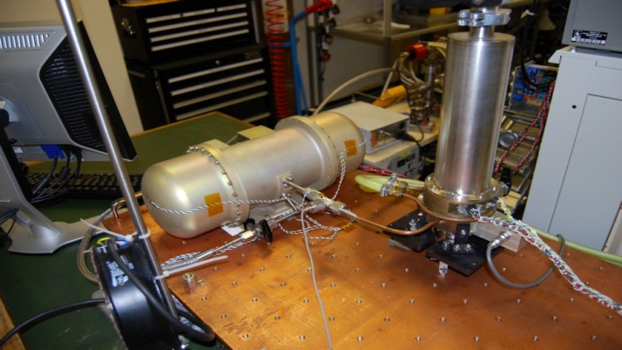
Receiver
Five receiver channels arranged with separation between cold mixer/LO assembly and warm IF and backend digital spectrometer
Low Temp.
Ambient Temp.
Cooling based on long heritage in Stirling Cycle coolers in Europe
New generation “Large scale cooler” will lift ~3 W at 50 K
120 W input power and 7 kg mass
Notes:
Here is a schematic representation of the receivers layout: 5 receiver channels arranged with separation
Cooling : at 1.5 THz we go down to 10K

Slide 17
Sensitivities
Assumptions: 1 K in 5 sec @ 1.5 THz (conservative)
30 K in 5 sec @ 5 THz (based on LOCUS)
1 MHz resolution
Telescope: effective 1.0 m diameter
Antenna theorem: A_{e}Ω_{a}=λ²
A_{e} = η_{a} A_{p}
where, η_{a} = 0.5, A_{p}=π (0.5)²
Conversion K to Jy : K/Jy = A_{e}/2k
Notes:
LOCUS : Low Cost Upper Atmosphere Sounder

Slide 18
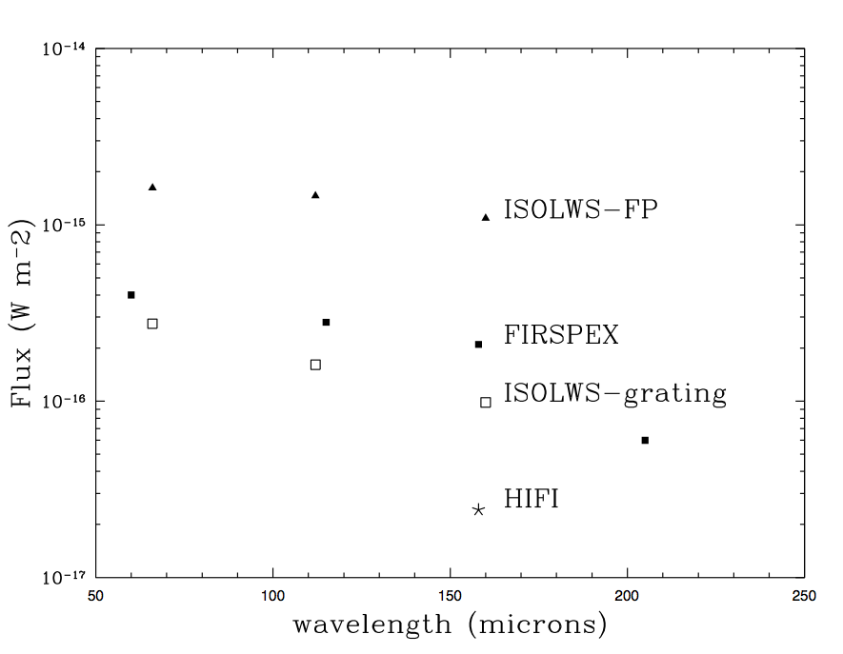
Sensitivities
Assuming 1 MHz resolution @ 1.5 THz

Slide 19
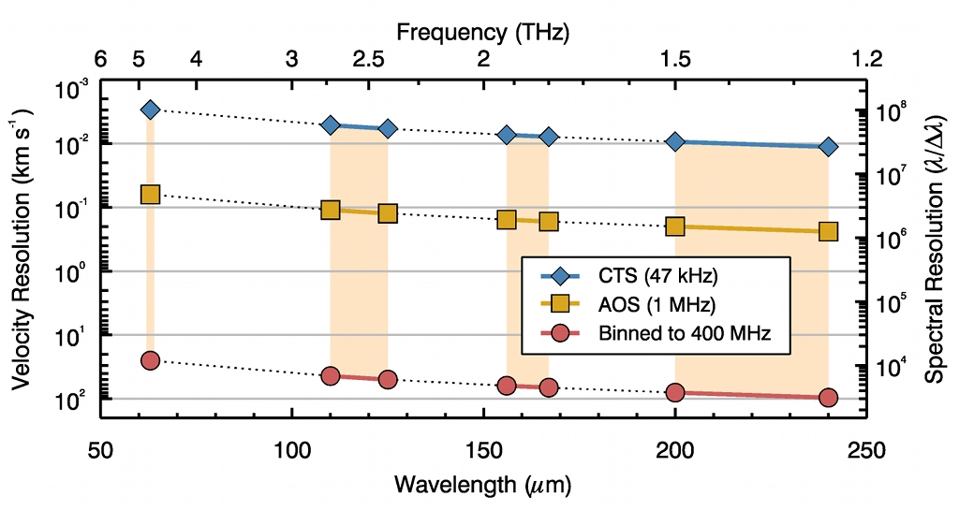
Achievable Spectral Resolution

Slide 20
Mission
Orbit is proposed as sun synchronous
Viewing direction is anti-Earth
Solar panels constantly illuminated
Radiators constantly face deep space
Full survey in 6 months with multiple passes over sky “bins”
Followup targeted observations
Notes:
The orbit naturally scans 1 degree per day on the sky with (assuming 90 minute orbit) 16 passes/deg in a day giving ~225 arcsec strips.
This implies we will need 5 or 6 diffraction limited detectors in a strip (40 arcsec beam at 1.5 THz) but somewhat lower at 4.7 THz.
Perhaps its best to adopt uniform PSF throughout the channels say 80 arcsec, then we would need 2 -3 detectors.

Slide 21
Concluding remarks
We propose the implementation of a high spectral resolution
Terahertz (THz) heterodyne receiver system for astronomical
research.
The instrument will consist of 5 detection bands covering key
atomic and molecular transitions in the far-infrared at high
spectral/spatial resolution.
Our goal is to observe simultaneously at the 5 bands covering
the IR sky
Our mission has great synergistic value with China Antarctica
Dome A TeraHertz Telescope (DATE5) and ALMA
Notes:
Add the Dome A Antarctica and the 5m telescope and the work that Cheng-Cai Shi is doing

Slide 22
Thank you
謝謝你

Slide 23
