Slide 1
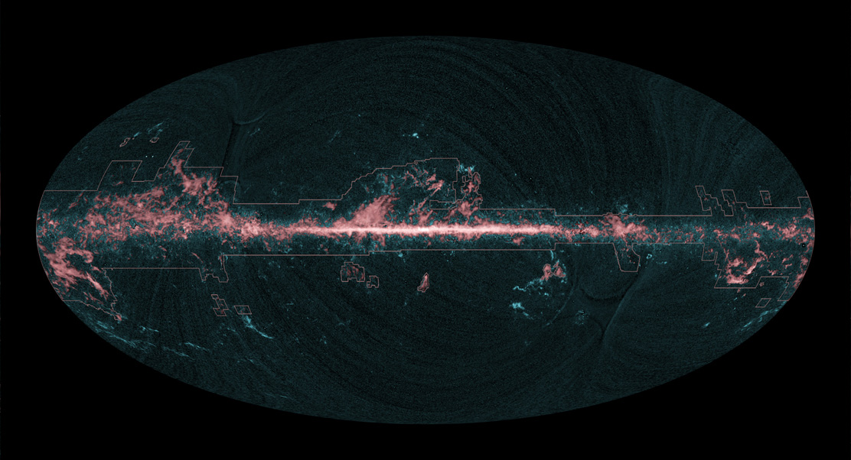




Far-Infrared Spectroscopic Explorer
- FIRSPEX -
PIs: D. Rigopoulou^{1,2} & J-S. Huang³
¹University of Oxford, ²RAL Space
³CAS-NAOC, Beijing
On behalf of the FIRSPEX Consortium
Background image Planck-ESA team
Notes:
Thank you, a big thank you also to the organisers for inviting my team to make a presentation and to our local host for providing an excellent environment for furthering of scientific collaborations. I will present our concept for a mission to carry out an all sky survey and pointed observation in 5 discreet far-infrared spectroscopiuc bands

Slide 2
FIRSPEX Team
PIs: D. Rigopoulou (UK) & J-S. Huang (NAOC)
Technical team: RAL: B. Swinyard, B. Ellison, C. Pearson
PMO: Y. Gao, S-C. Shi, J. Hu
E. Caux (IRAP, FR) S. Molinari (IAPS-INAF, IT)
M. Huang (NAOC, China) F. Helmich (SRON, NL)
D. Clements (IC, UK) S. Viti (UCL, UK)
S.C. Shi (PMO, China) Yu Gao (PMO, China)
Y. Delorme (Obs Paris, FR) E. Lichfield (Leeds, UK) V. Charmandaris (NOA, GR) C.N. Hao (Tianjin,NU, China)
W. Zhong (NAOC, China) X.Y. Xia (Tianjin,NU, China)
X. Liu (China) Je Hu (PMO)
M.J. Griffin (Cardiff, UK) D. Li (NAOC, China)
J. R. Gao (SRON, NL) M. Wiedner (Obs. Paris, FR)
L. Hao (Shanghai, China) Ji Yang (PMO, China)

Slide 3
What is FIRSPEX ?
FIRSPEX is a joint ESA–CAS candidate small mission operating in THz (>0.5 THz) frequency range.
Builds on European heritage in space technology and long standing collaboration with Chinese Institutions.
Uses `old & tested’ technology but with a `new twist’ to push new technological frontiers, does NOT require cooling down to 4K (but only ~20K)
Cost effective space mission aiming to push the supra-THz technology forward and deliver, for the first time, unique 3D maps of the infrared sky.
Notes:
You can be very positive and state that the type of cryogenic system that we are propsoing to use is compact, power efficient, and has a demonstrated lifetime well in excesss of that of the mission. Plus, similar units have flown in space and used extensively for Earth observation, e.g aboard the Advanced Along-Track Scanning Radiometer (AATSR).

Slide 4
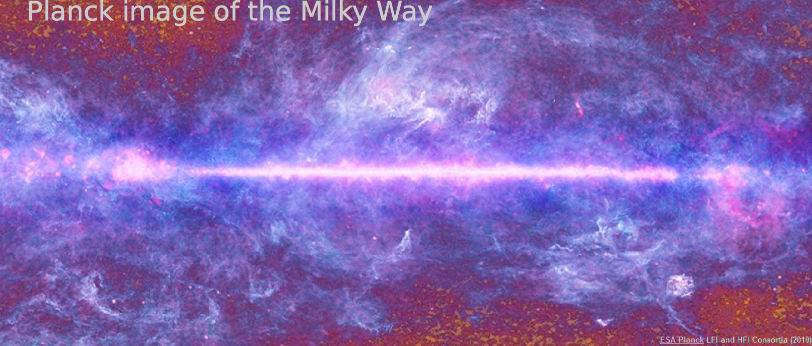
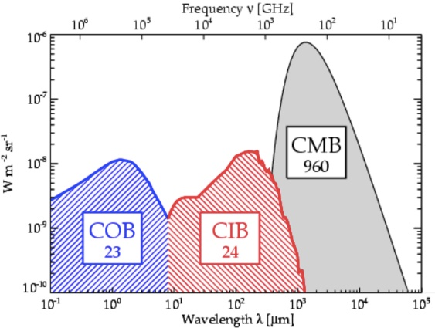
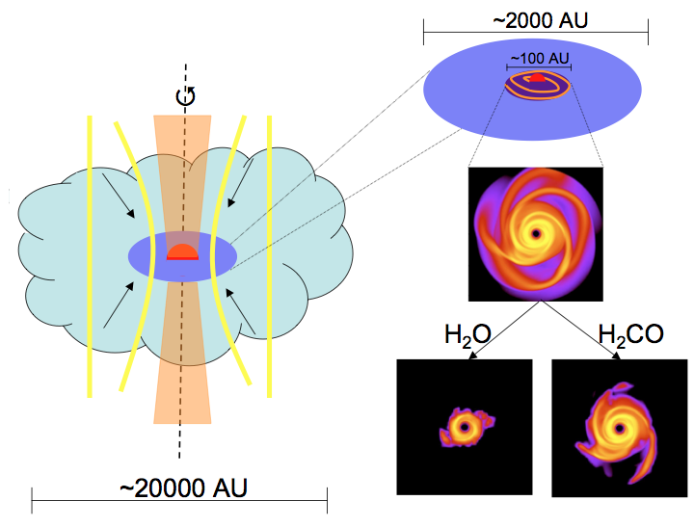
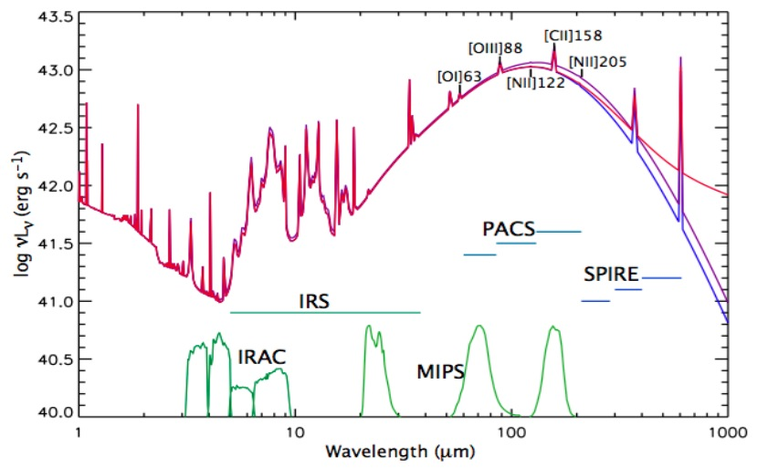
Why far-infrared?
Cosmic Infrared Background
The dawn of protoplanetary disks
Study the ISM
Early stages of star formation
Cooling processes in galaxies
Formation of complex molecules
Gas Grain chemistry
Notes:
Infrared Astronomy is ``younger’’ than other astronomical disciplines however, great strides have taken place in the last 30 years (since IRAS flew in 1985). Mention previous balloon missions. It is now well established that the cosmic infrared background is at least as strong as the optical one. Another area that benefits from studies in the infrared is that of the early stages of star formation. In spectroscopy the FIR is host to a series of important lines known as cooling lines that provide invaluable insight into the complex physical processes that take place in the ISM MENTION THE ESA KEY THEMES

Slide 5
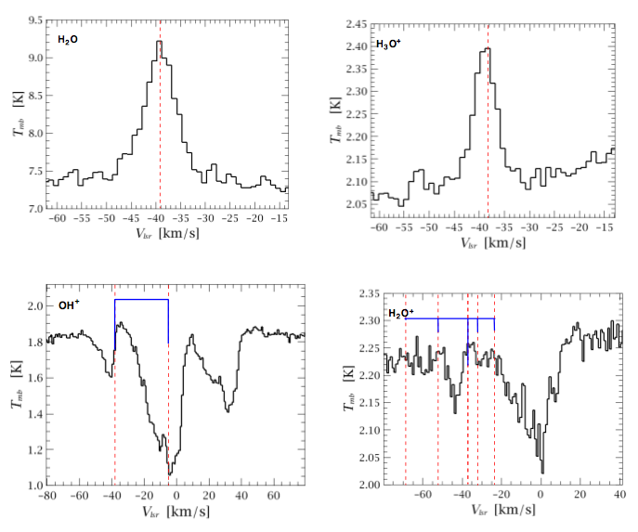
Herschel Heritage
Mrk231 (Gonzalez-Alfonso et al. 2011)
The WISH project (Kristensen et al. 2012
GOT C⁺ team (Pineda et al. (2013)
Notes:
The recent advent of the Herschel mission demonstrated the immense power of FIR spectroscopy in disentagling the role of atomic, molecular and ionic gas in our Galaxy and external galaxies. However, we only seem to have scratched the tip of the iceberg…. Spectroscopic observations on Herschel cover 1% of sky

Slide 6
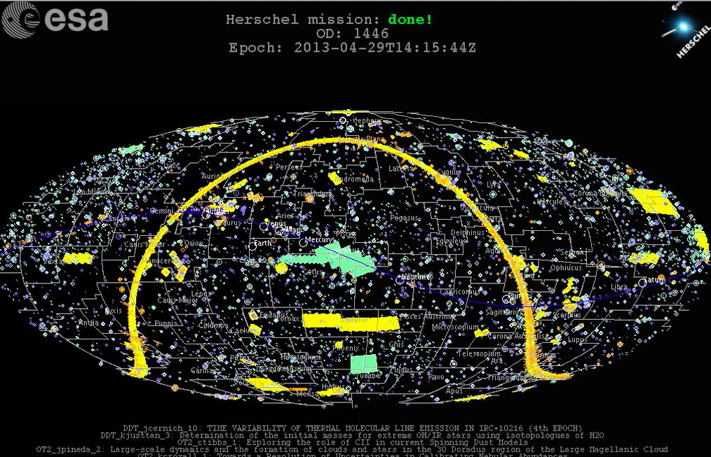
But Herschel surveyed 10% of the total IR sky!
Why do we need FIRSPEX since we have the Herschel Legacy?

Slide 7
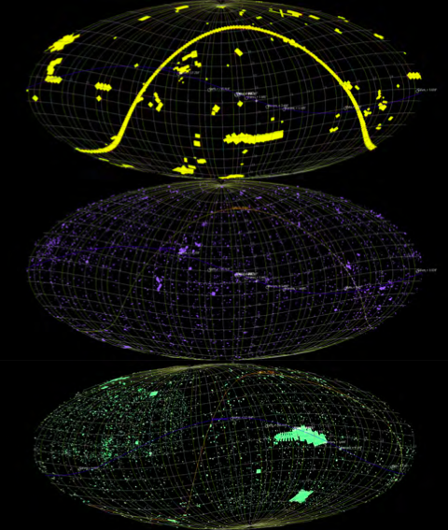
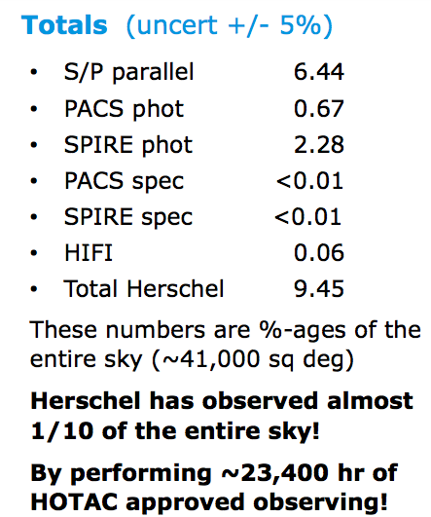

Slide 8
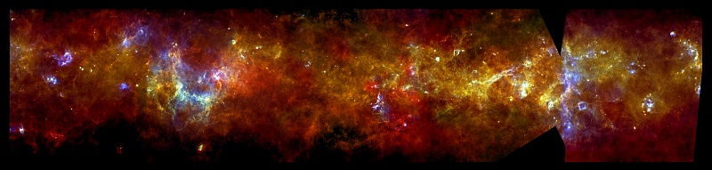
But no spectroscopic equivalent to the
Herschel continuum survey of the Galactic Plane
The Herschel infrared Galactic Plane Survey (Hi-GAL)
PI: S. Molinari
Notes:
Thanks to the superb imaging capabilities of Herschel SPIRE+PACS we now have a panoramic view of the galactic plane and can answer many important questions:
how much dust is there in the Galaxy, and what fraction of the overall galactic mass does this represent?
How do the proportions of dust to gas vary throughout the Galaxy?
How efficiently do stars form in different parts of the Galaxy?
How similar is our Galaxy to others in terms of star formation?

Slide 9
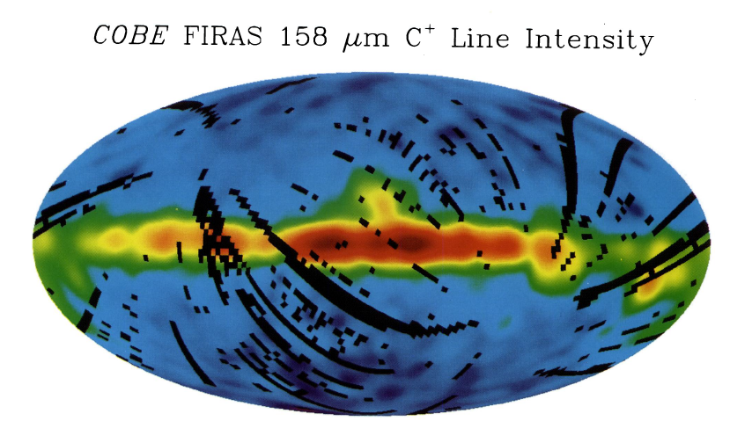
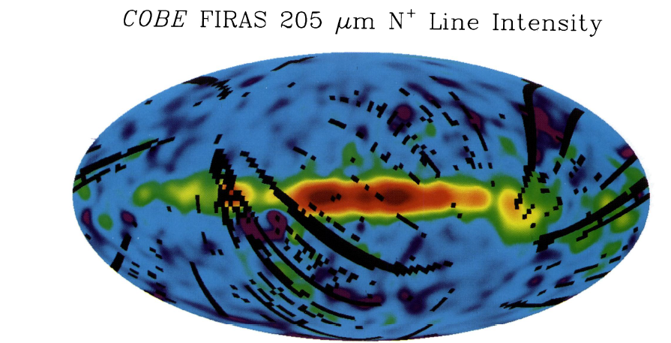
Heritage
COBE/FIRAS low resolution map in [CII],[NII] Bennett et al ’94
probe the CNM (Bennet et al 94), WIM (Heiles et al 94)
PDRs (Cubick et al. 08)
Spatial resolution 7°
Spectral res: 1000 km/sec
Notes:
The FIRAS instrument on COBE conducted a low resolution (spectral/angular) mapping of the [CII] in our Galaxy aiming to disentangle contributions from the cold neutral vs warm matetial and PDR (ie neutral vs ionized)
They found that in the Galactic plane the [CII] and [NII] distributions were similar but the intensities are different. C+ arises from cold neutral medium whereas NII from warm ionized medium. Studying these important cooling lines can help us disentagle the phases of the ISM. At high galactic latitude the C+ emission fall faster than IR indicating that the high galactic latitute fir emissio n has a different origin.

Slide 10
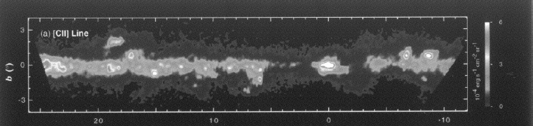
Balloon-borne Infrared [CII] Explorer (BICE)
Galactic Longitude in degrees
angular resolution: 15 arcmin
spectral resolution : 175 km/sec
Nakagawa et al. (1998)
Notes:
Subsequent ballon born missions line BICE but again limited survey and resolution

Slide 11
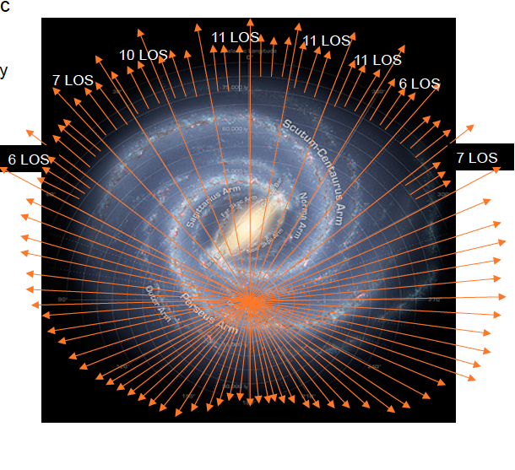
The Herschel-HIFI survey of [CII] in the Galaxy
(the GOT C⁺ team)
Galactic Plane and Galactic Central Regions Survey
[CII] emission in the Galaxy mostly
related to spiral arms, tracing clouds
transiting from atomic to molecular.
But to fully trace properties of ISM
we need large scale [CII] , [NII], [OI]
maps of the Galaxy and Nearby Galaxies
FIRSPEX survey
GOT C⁺ team (Pineda et al. (2013)
Notes:
More recently the HIFI carried out a survey of [CII] in the Galaxy The Galactic Observations of Terahertz C+: – Galactic Plane, looked at various LOS :
CII important for understanding the life cycle of ISM
Velocity-resolved observations of [C ii] are the most powerful technique available to disentangle the emission produced by
these components. These observations can also be used to trace CO-dark H2 gas and determine the total mass of the ISM.
Methods. The Galactic Observations of Terahertz C+ (GOTC+) project surveys the [C ii] 158 μm line over the entire Galactic

Slide 12
What science can FIRSPEX deliver?
Two main considerations:
Sensitivity
Spectral Resolution
FIRSPEX science is unique and proposes to fill in an
important gap: `a panoramic spectroscopic view’
of the IR sky.

Slide 13
Sensitivities
Assumptions: 1 K in 5 sec @ 1.5 THz (conservative)
30 K in 5 sec @ 5 THz (based on LOCUS)
1 MHz resolution
Telescope: effective 1.0 m diameter
Antenna theorem: A_{e}Ω_{a}=λ²
A_{e} = η_{a} A_{p}
where, η_{a} = 0.5, A_{p}=π (0.5)²
Conversion K to Jy : K/Jy = A_{e}/2k
Notes:
LOCUS : Low Cost Upper Atmosphere Sounder

Slide 14
Sensitivities
Assuming 1 MHz resolution @ 1.5 THz

Slide 15
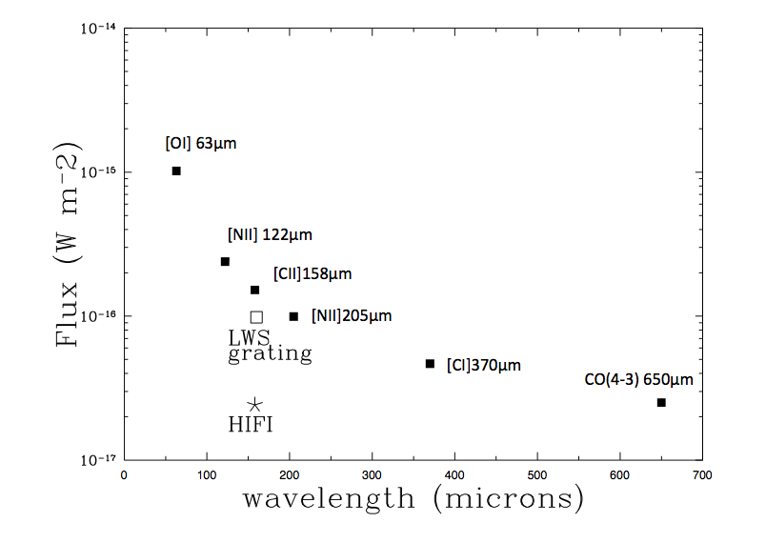
Sensitivities
Assuming 1 MHz resolution @ 1.5 THz

Slide 16
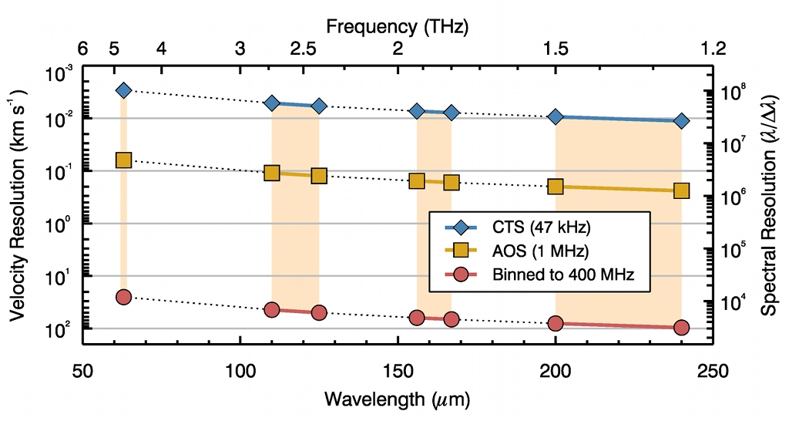
Achievable Spectral Resolution

Slide 17
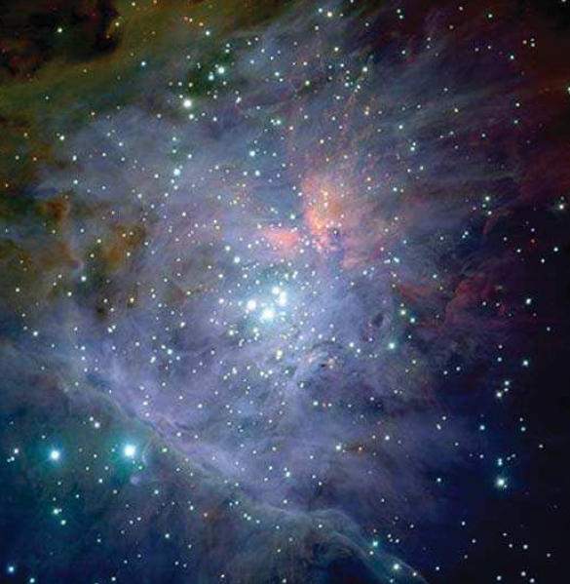
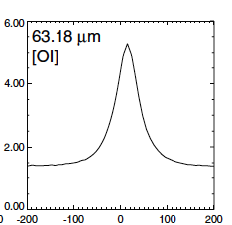
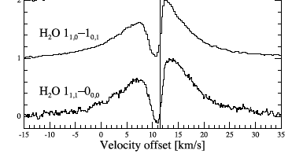
Resolution is key ….
[OI] in Orion -KL
ISO-LWS
Lerate et al. 2006
Physical
conditions
in Star forming
regions
Water in Orion-KL
HIFI
Kama et al. 2013
Notes:
Two points point to make
What are the characteristics of the new mission?
Resolution is key….
And of course sensitivity

Slide 18
The choice of spectral lines
Primary lines/channels:
(OI) 63μm (4.7 THz)
[CII] 158 μm (1.9 THz)
[NII]205μm (1.46 THz)
Additional bands/channels under consideration:
CO(4-3) 650μm (0.46 Thz): bootstrap FIRSPEX to
ground based surveys
[CI] 370μm (0.89THz) : crucial to obtain [CI]/[CII] ratio
=> C abundance
[OH] 119μm (interesting but hard), [NII] 122μm
C,N,O

Slide 19
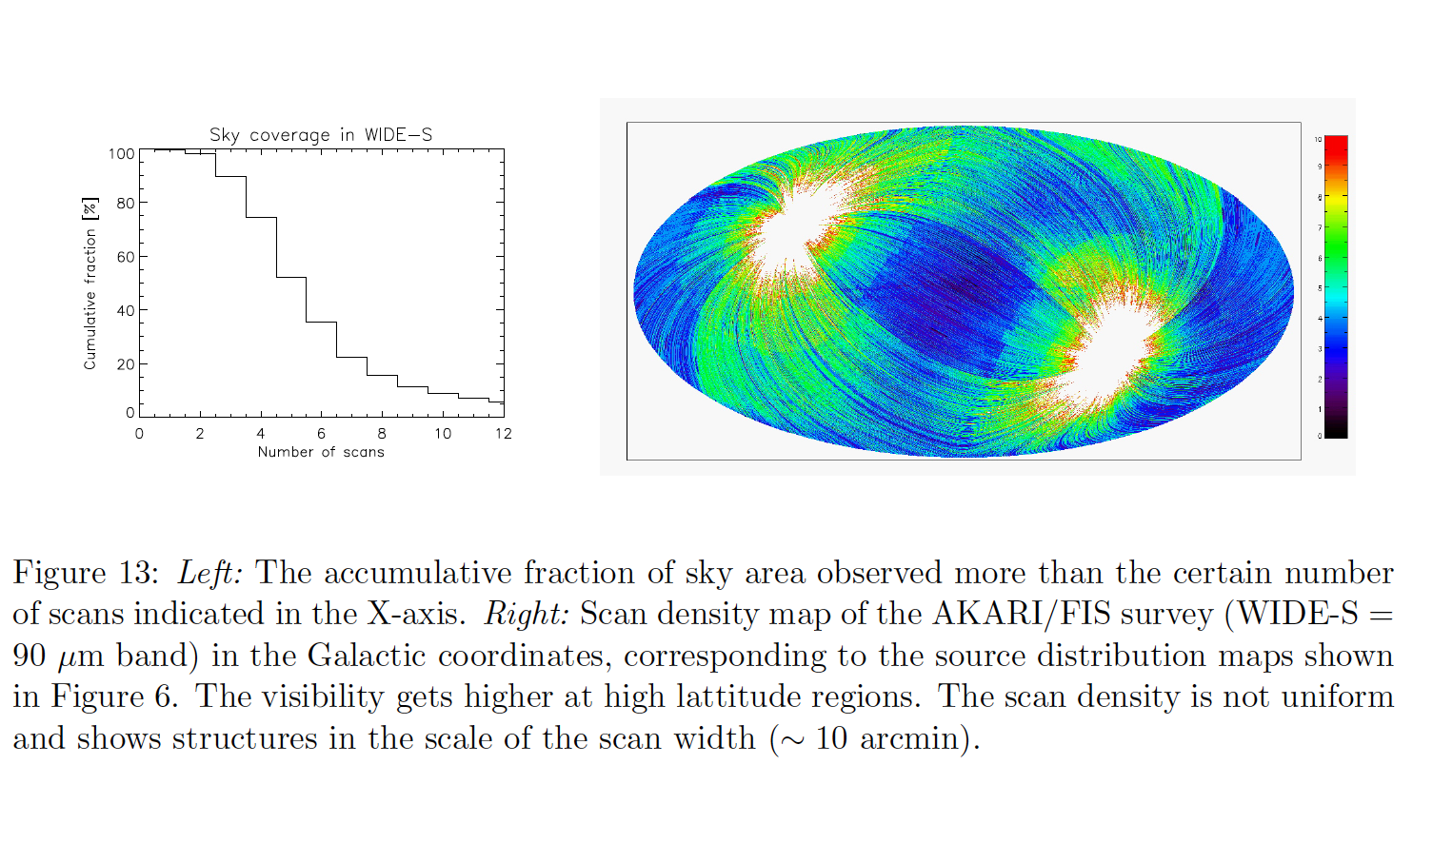
FIRSPEX primary science goal
Perform ``all-sky’’ survey
(spectroscopic equivalent of the IRAS/AKARI missions)

Slide 20
What will the `full sky’ survey offer?
(or why wasn’t Herschel enough?)
Trace the distribution of fundamental
elements: C, N, O
Provide a first census of `how much stuff’ is
there of `atomic’, `ionic’, molecular material
Delineate the transition of atomic to molecular
clouds: essential for understanding stellar evolution

Slide 21
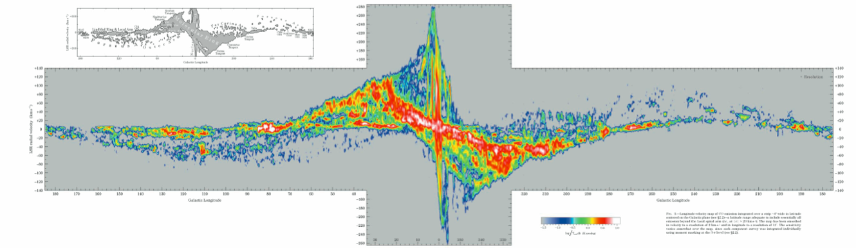
FIRSPEX All-Sky Survey
CO(1-0) map of the Milky Way (Dame et al. 2001)

Slide 22
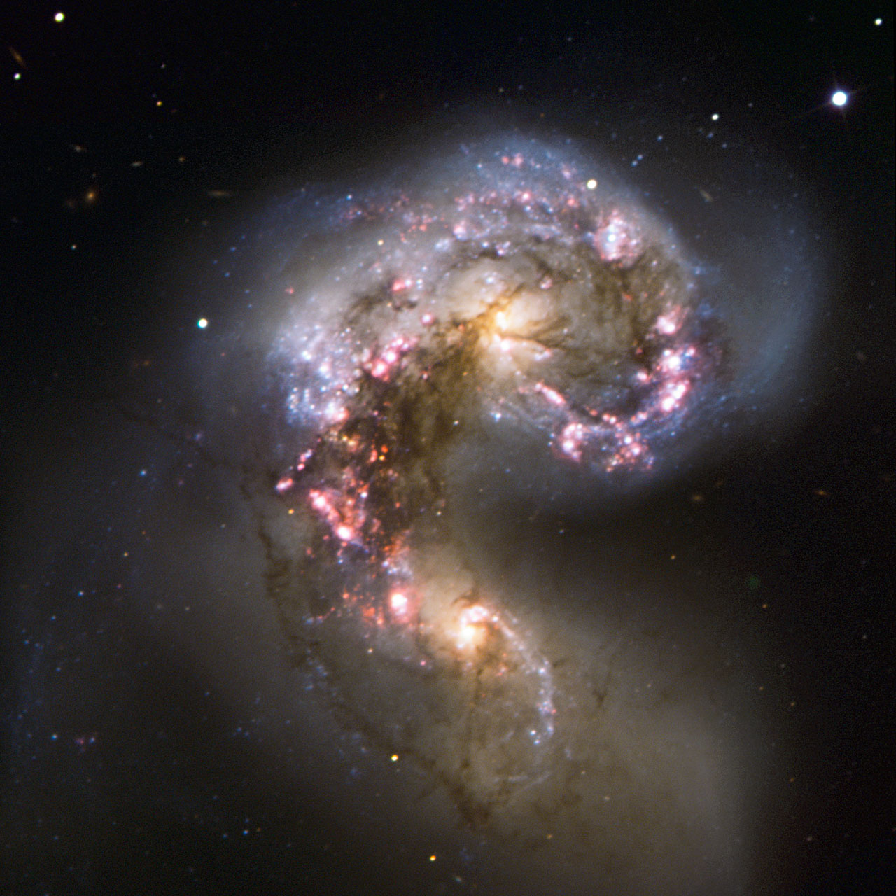
3D maps of nearby galaxies
Nearby Galaxies: 3D mapping
The atomic and molecular distribution can be used to disentangle the different gas components and to trace individual energetic processes within a galaxy (e.g. star formation, X-rays, shocks…)
Notes:
Herschel –HIFI did this for a few selected areas of `galactic regions’ FIRSPEX will do it for nearby galaxies

Slide 23
“Decomposing a galaxy”: the most important species
NII: can be used to estimate the ionized gas contribution to the CII fluxes
O: it is present in both atomic and molecular gas; ratios of its transitions can give the optical depth
CII: a true tracer of the PDR zone if its HII contribution is small;
OI/CII → diagnostics of temperature, densities and radiation field of the gas
C: very correlated with H₂ and CO
CO: traces the amount and distribution of molecular gas at large scale → mass of the galaxy

Slide 24
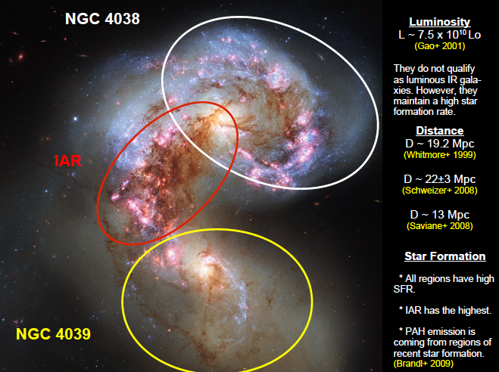
Notes:
An example study: the Antenna galaxies

Slide 25
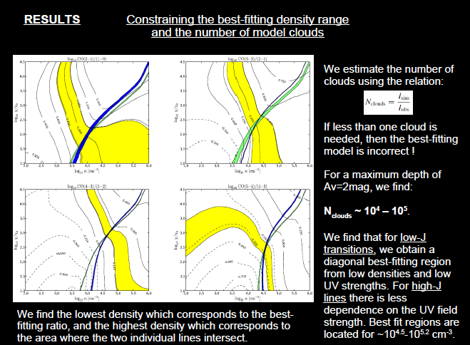
Bisbas et al. 2014
Using 3D PDR model
Notes:
Here the point to make is simply that although we had multiple transitions and species, they were all from different telescopes, and there was no way of ‘disentangling’ the spatial information

Slide 26
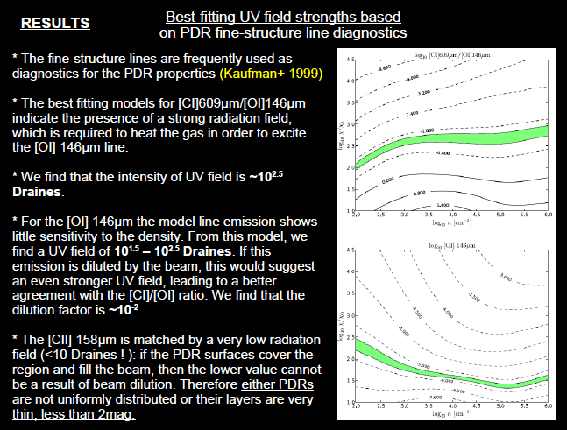
Bisbas et al. 2014
Notes:
Lines are insensitive to density

Slide 27
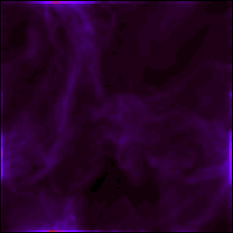
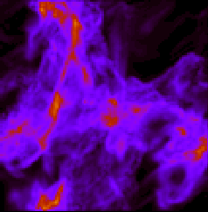
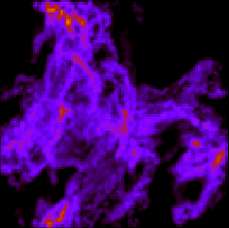
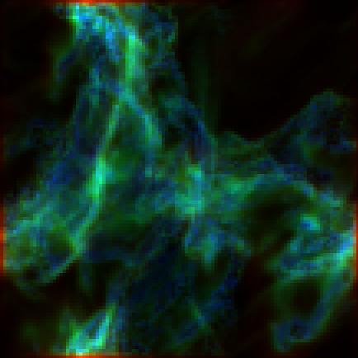
3D study of nearby galaxies in C, CII, CO with 3DPDR
CII 158μm
CI 610μm
CO (1-0)
Emission maps of turbulent clouds simulated using the ORION hydro grid code and post-processed with 3D-PDR.
Red: CII 158μm
Green: CI 610μm
Blue: CO (1-0)
Offner et al. 2013
Notes:
Here the point is that PDR models coupled with hydro models can already produce the synthetic 3D structure that FIRSPEX can give us

Slide 28
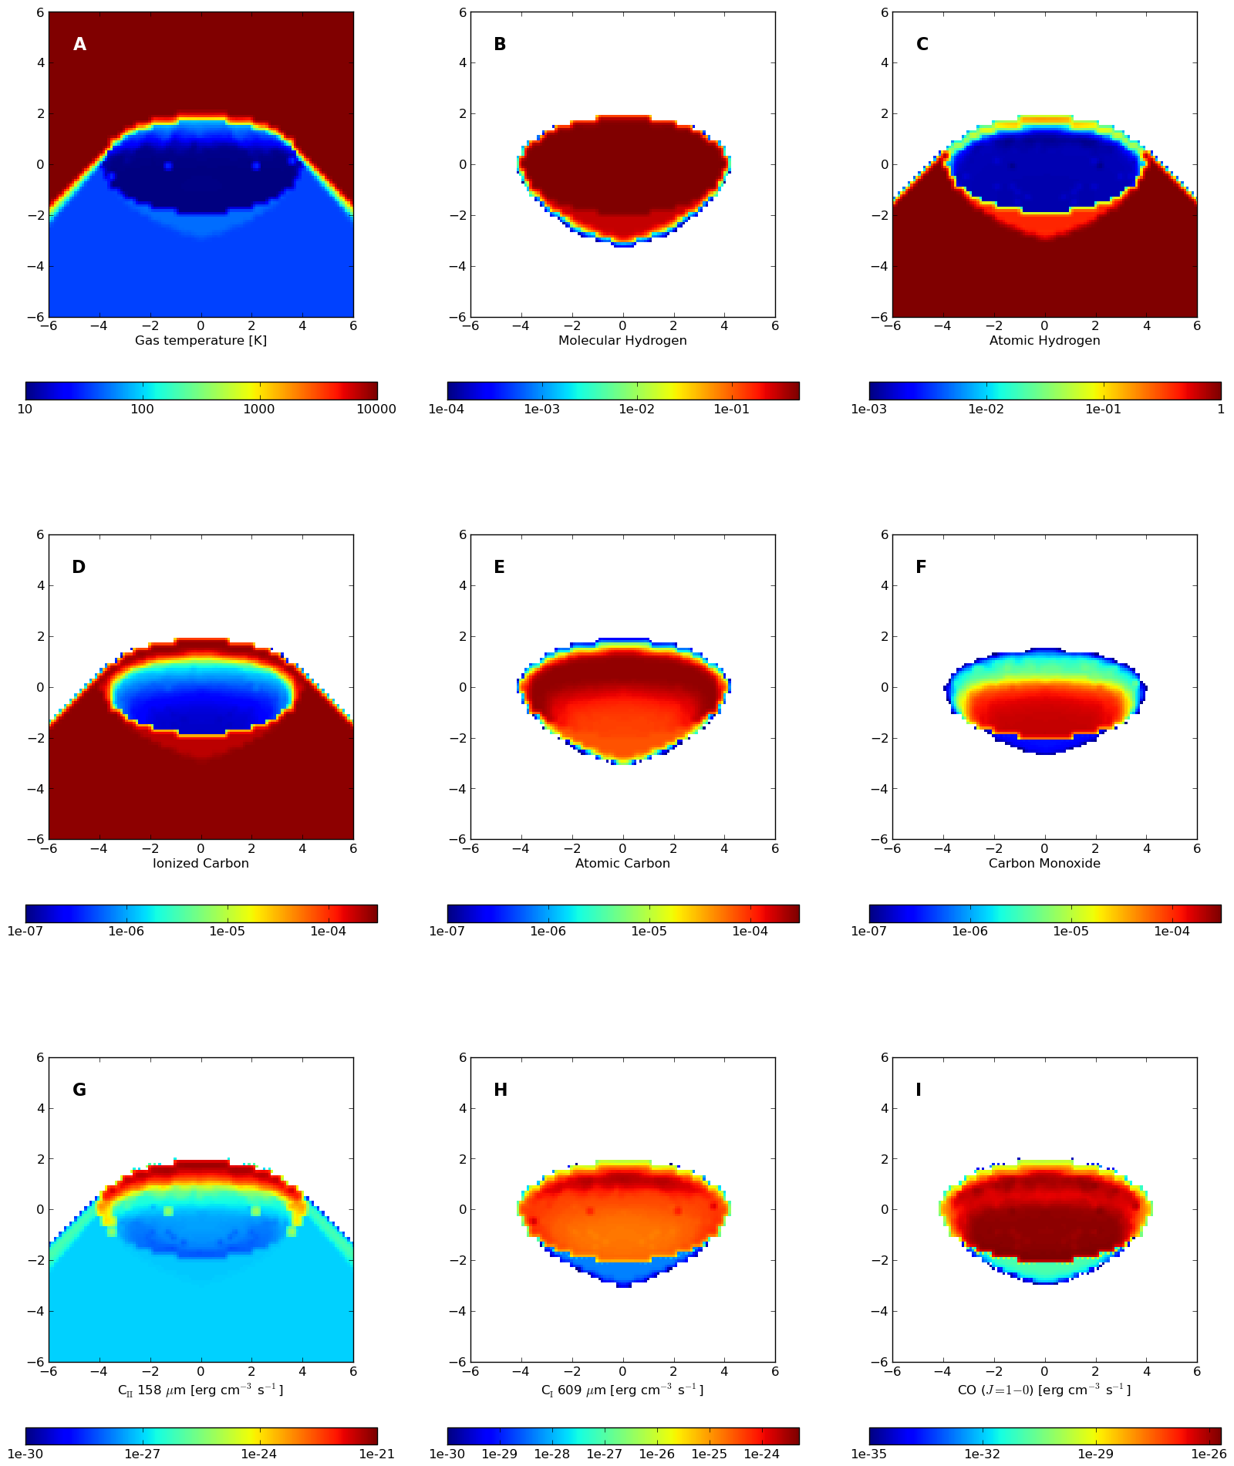
What is the next step?
TORUS-3DPDR (Bisbas et al. in prep): a 3D model of photoionization+PDR regions
Bisbas et al. in prep
Notes:
And here the point is that we can now, ‘in one go’, model in 3D both the photoionization gas and the PDR gas.
Cross section plots of a simulation: axes are in pc panel A shows gas temperature distribution – panels b-f show the distribution of H2, HI, CII, CI, CO abundances of species are fractional – panels G-I show local emissivity of CII 158 micr, CI 609 micr and CO 1-0 respectively
Colours bars in erg cm-3 s-1

Slide 29
Nearby galaxies
With 3D surveys of key transitions of [NII], [CI], [CII] and [OI] we could get the average gas contained within each component (HII, PDR, neutral) for each type of galaxy
how do the contributions differ across types of galaxies?
The answer should be a lot since the differences between HII, PDRs and netrual gas is mainly to do with energetics!

Slide 30
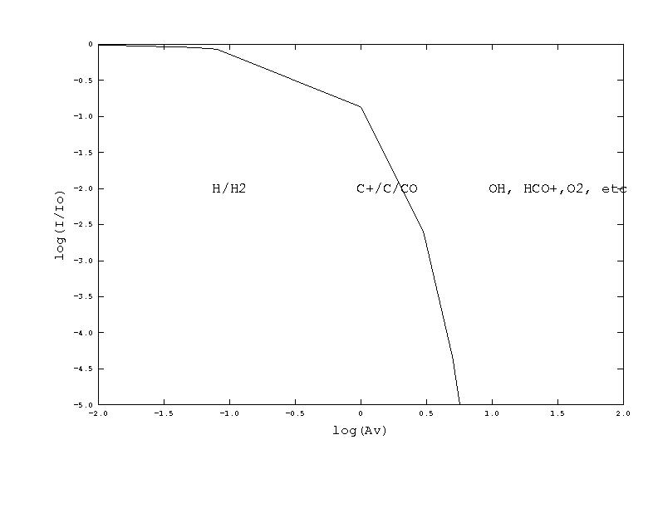
PDR
MC
HII
‘Canonical” PDR interfacing with an HII region and a molecular cloud, showing how UV intensity varies with depth, and the depths at which some important chemical transitions occur.

Slide 31
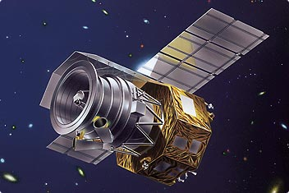
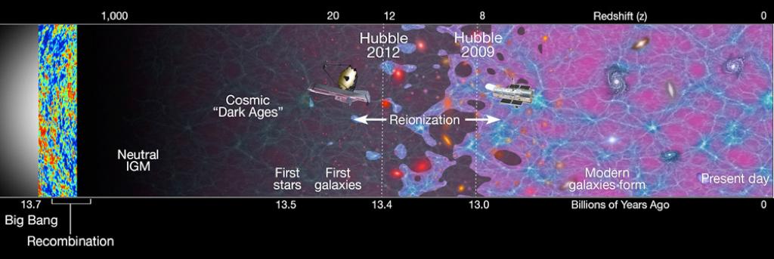
Very high redshift Universe
FIRSPEX
Can FIRSPEX `really’ reach the `DARK AGES’ ?

Slide 32
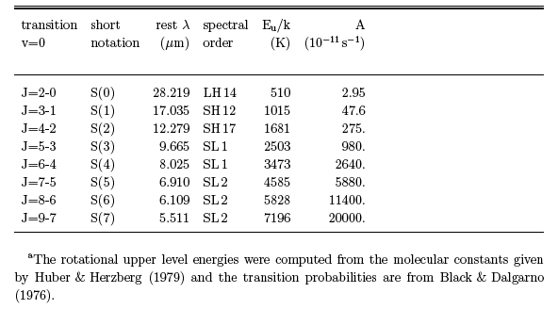
Molecular Hydrogen H₂ mid-infrared pure rotational transitions
For redshifts z~16 (Dark Ages) : H2S(3) shifts to [CII] 158 μm channel
But can FIRSPEX detect H2?

Slide 33
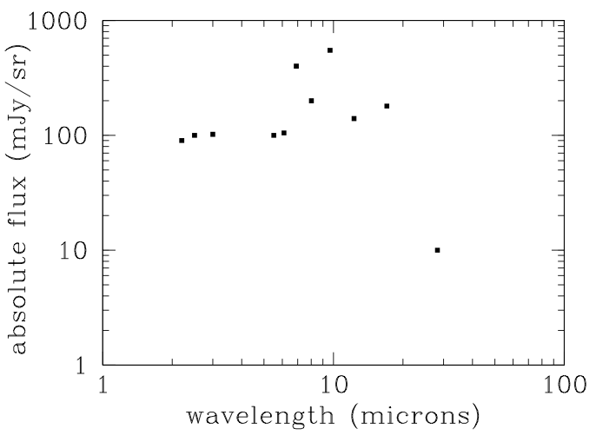
Strength of EoR mid-infrared H2 lines from Gong et al. 2013
H2S(3): 6mJy/sr
H2S(5): 4mJy/sr

Slide 34
Sensitivity Estimates
Use 2x10⁻¹⁶ W/m² as sensitivity of each 1MHz channel = 2 x 10⁴ Jy
Assume 5GHz band => 5000 1MHz channels
Combine these 5000 channels to get broadband sensitivity of 300 Jy
Assume beamsize of 1’ given diffraction limit of 1m telescope at 200 microns
Bin up signal over 1sr to get integrated SB sensitivity: 1sr = 3300 sq deg = 1.2 x 10⁷ beams
Sensitivity on sr scales is then 300/3400 = 0.9 Jy/sr
Expected mean integrated H2 flux for 9.66 micron line is ~6Jy/sr => detection!
Preliminary Estimates

Slide 35
Other considerations
z=16.37 was chosen so that the next brightest H2 line would lie in the FIRSPEX 158 band
Can do a correlation detection to remove foregrounds & boost robustness
z~16 also interesting as this is when first stars are thought to be forming => H2 emission might be enhanced

Slide 36
The Payload

Slide 37
Payload
Small mission provides excellent science opportunity.
Limited payload resources – low power, low mass, and small volume.
Cryogenic cooling to 4K too demanding with present technology, but ~20-50 K is viable.
Semiconductor (Schottky) mixer technology compliant with higher ambient temperature operation
Schottky offers good sensitivity and wide IF bandwidth.
Quantum Cascade Laser (QCL) Technology provides sufficient mixer LO power.
Proposed concept has the advantage of low cost cooling and relatively rapid mission deployment (~5-6 yrs)
Notes:
When thinking about FIR spectroscopy from space the choice is superconducting receivers
Given that a spacecraft in the small mission category use of 4K cooling systems is prohibitive. We therefore propose to use an alternative and well known detection technology that relies on semiconductor (Scottky) diode mixing which has the distinct advantage of higher ambient temperature operation, typically ~20K for best sensitivity.
Although NOT as sensitivite as superconducting receivers still ecellent sensitivity and S/N.
Noise Temp: 4000K at 1.5 THz , 1MHz. / 50,000K at 4.7K (assuming cooling down to 40-50K)
QCLs have been demonstrated tp provide 5mW continuous power at 40K. This value can go up to 10mW expectation and higher temp

Slide 38
Detector Requirements
Target spectral regions (channels) from 0.4 THz to 4.7THz.
Sufficiently sensitive to return useful science.
High spectral resolution ~1MHz.
Wide instantaneous bandwidth ~ 5GHz/channel.
Simultaneous operation of channels.
Compliant with small satellite operation ⇒ low mass, small volume and low power consumption.

Slide 39
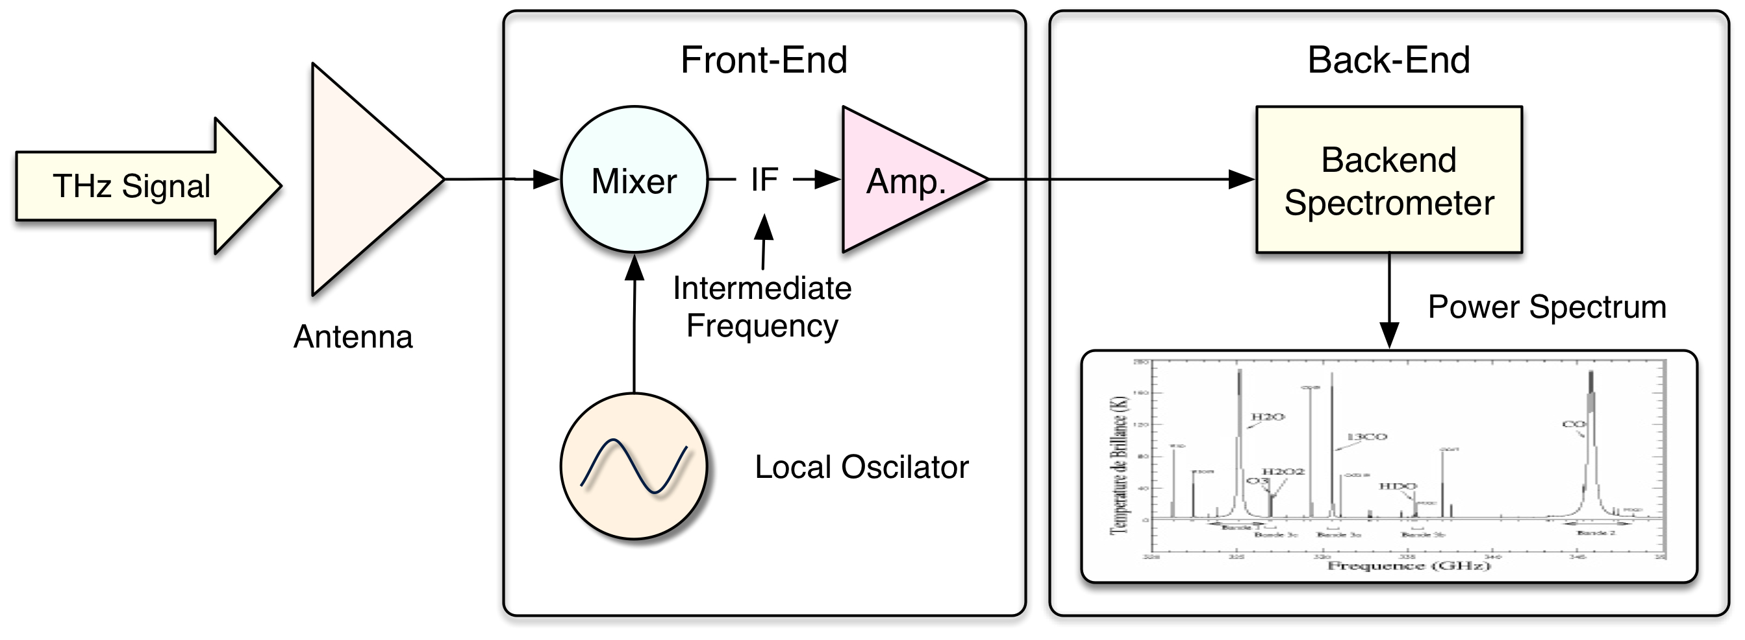
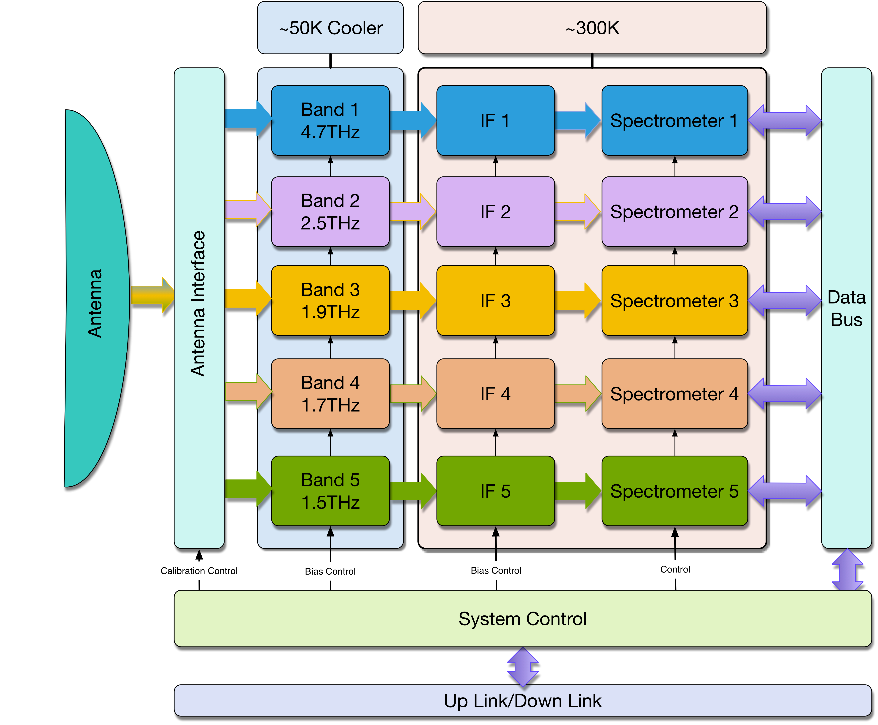
Detection Method
Spectral resolution requirement ⇒ heterodyne receiver technique.
THz frequency mixing used for front-end.
High-speed digital fast Fourier
Transform spectrometer (FFTS)
for back-end.
Cannot encompass entire frequency
range via a single receiver
Subdivide into 5 discrete channels.
0.8THz
0.4THz

Slide 40
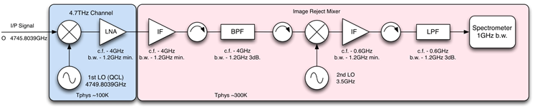
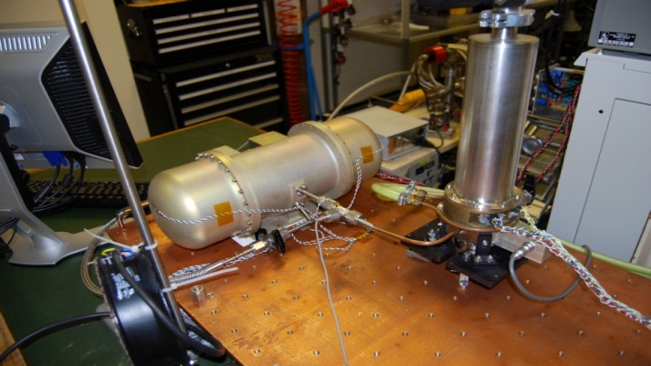
Receiver
Five receiver channels arranged with separation between cold mixer/LO assembly and warm IF and backend digital spectrometer
Low Temp.
Ambient Temp.
Cooling based on long heritage in Stirling Cycle coolers in Europe
New generation “Large scale cooler” will lift ~3 W at 50 K
120 W input power and 7 kg mass
Notes:
Here is a schematic representation of the receivers layout: 5 receiver channels arranged with separation
Cooling : at 1.5 THz we go down to 10K

Slide 41
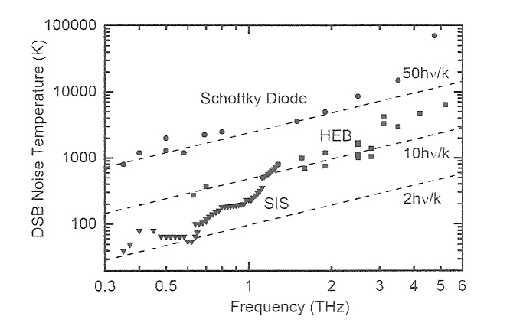
Front-end Mixer Selection
Superconducting mixers offer best sensitivity <=1THz.
At >1THz SIS devices less effective due to material energy gap limit.
Supercon. HEB devices sensitive at >>1THz. But,
  Have limited IF bandwidth, ~3GHz.
  Present materials require 4K cooling ⇒ incompatibility with small satellite.
  Some reported concerns over saturation and stability - maybe not relevant.
Alternative is the Schottky diode mixer.

Slide 42
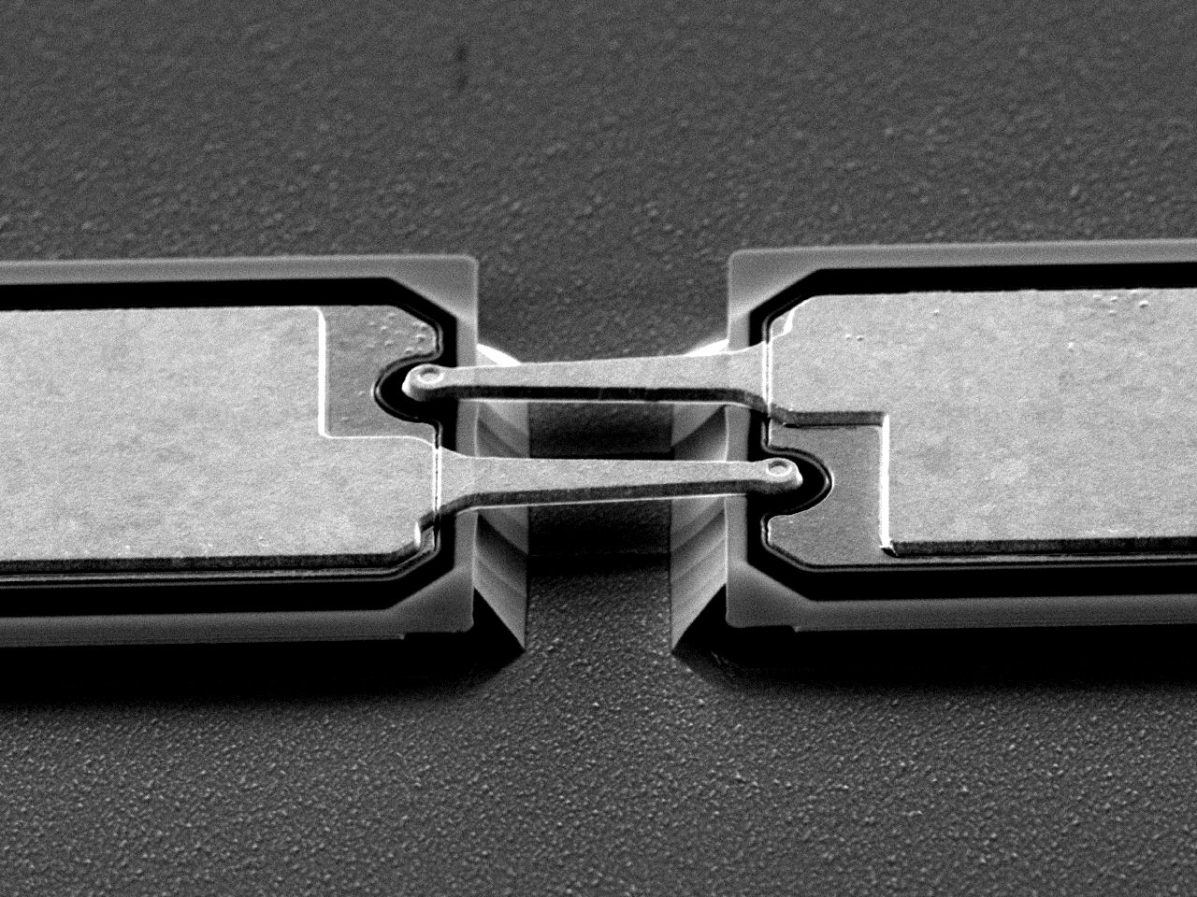
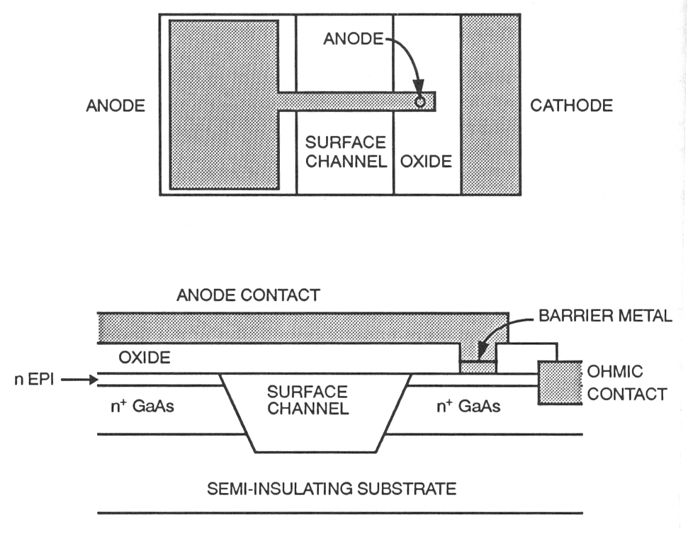
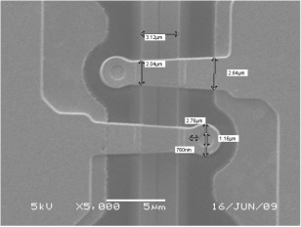
Schottky Mixer
Semiconductor device capable of multi-THz operation.
Historically a key detector in early mm/submm-wave astronomy. Now used extensively in Earth observation
Used extensively in space and up to 2.5 THz.
Wide IF bandwidth possible >>5GHz.
Operates at room or cryogenic temperatures.
Can be configured in single or balanced diode structures.
Less sensitive than supercon. and needs more LO power.
Planar Structure
Base Material GaAs
(Ref: Mass)
RAL Double Diode
Example.

Slide 43
Receiver Configuration
Assume a fixed primary antenna with minimal fore-optics interface.
Schottky receivers placed in a focal plane array configuration.
Calibrate via a room temp target & off source space view.
Single active (Stirling) cryogenic system used for cooling.
Band | Freq. THz | Tsys K SSB | Mxr Config. | LO Type | Comment
1 | 4.7 | 80,000 | Fundamental | QCL | OK
2 | 2.5 | 20,000 | Fundamental | QCL | QCL likely needs <50K
3 | 1.9 | 5,000 | 4th Harmonic | Harmonic | Performance & LO
4 | 0.8 | 1,500 | Sub-harmonic | Harmonic | OK
5 | 0.4 | 1,000 | Sub-Harmonic | Harmonic | OK
Europe
china
Power requirement: 65-70 W, effort to bring this lower

Slide 44
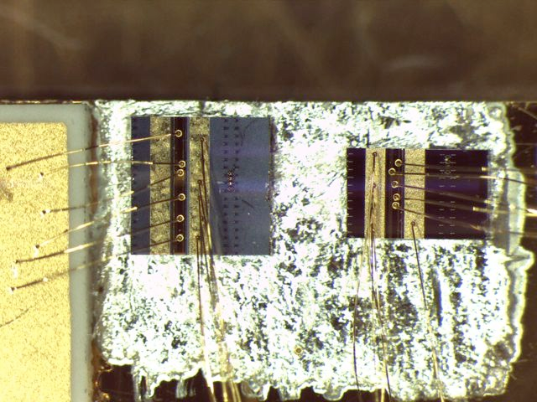

QCL FIR Laser device developed at Leeds University
Planar Schottky mixer diode
developed at RAL-Space
Exploring alternatives in collaboration with Purple Mountain Observatory colleagues
Notes:
To repeat Prof. Zarnecki’s statements when phased with a new mission we should try something that hasn’t been tried before….
But not necessarily ``expensive’’ mission…

Slide 45
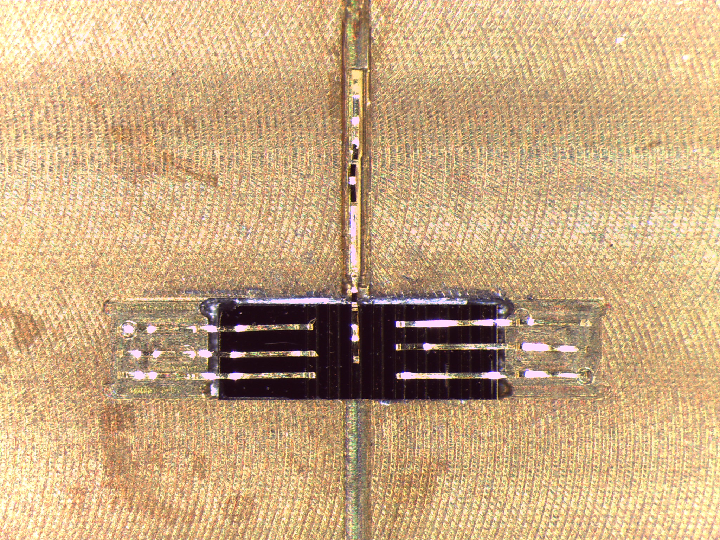
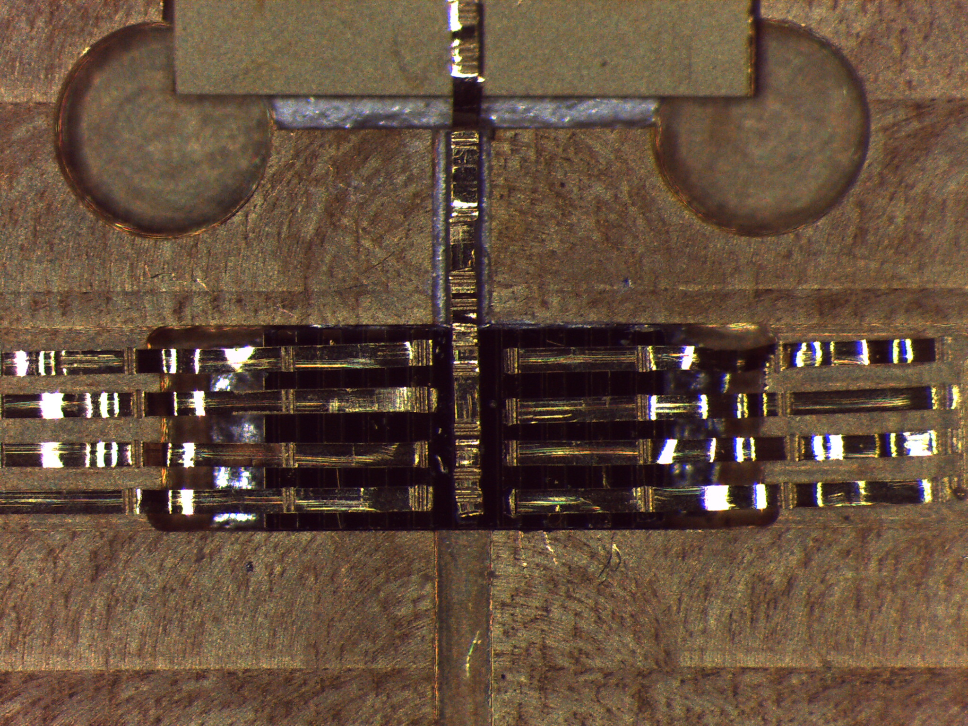
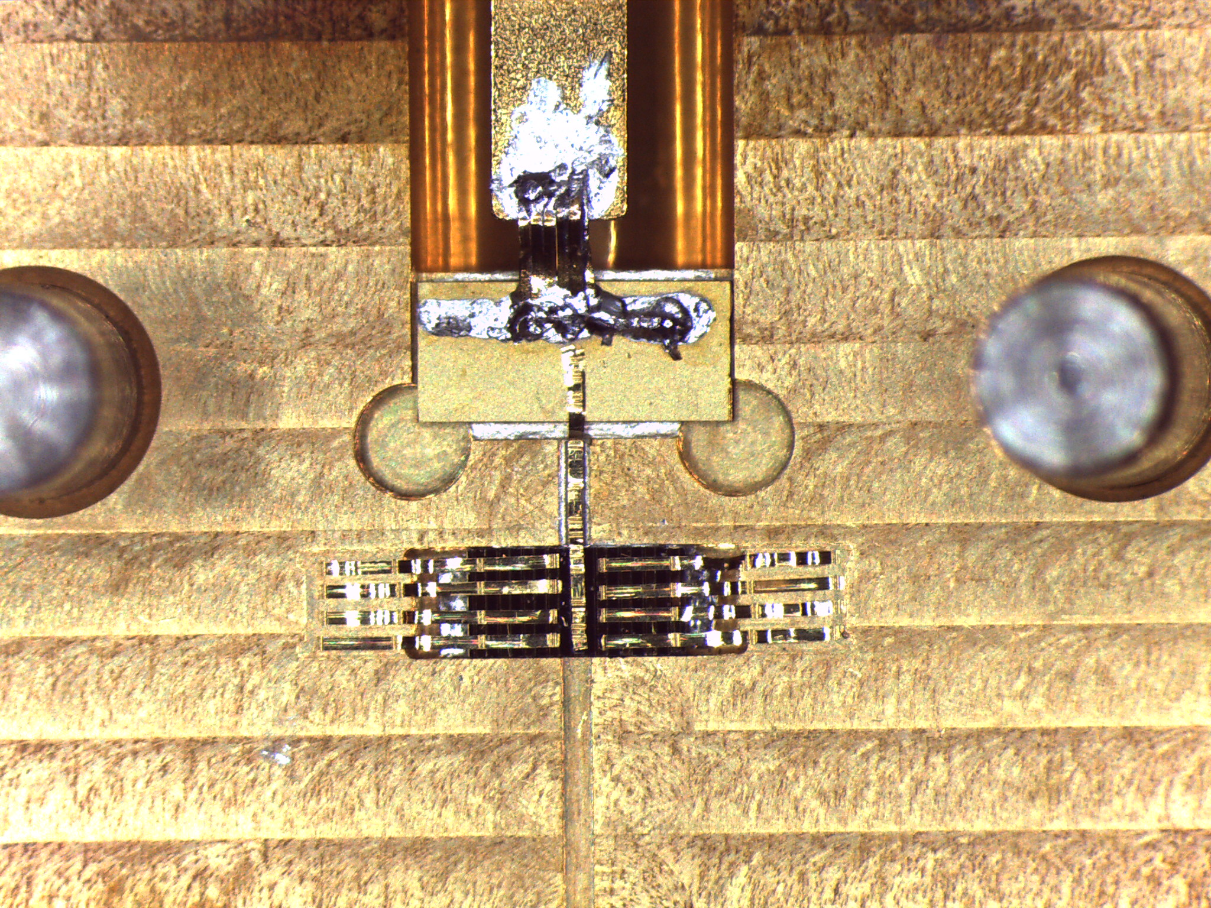
Initial work (RAL/Leeds)
Work on 4.7 THz QCL (RAL/Leeds)
• Complete block currently being fabricated, and was tested in August 2014.
Funded by NERC

Slide 46
Work-Packages
Europe (RAL): configuration of payload (joint)
(RAL/Obs Paris): high frequency (THz) bands
(Leeds) : QCLs
China (PMO): configuration of payload (joint)
low frequency (GHz) bands
Europe (SSTL): bus
Europe/China: launcher (under investigation)
Opportunities for industry/other companies (e.g. Teratech)

Slide 47
Examples of platform options – SSTL-150
FIRSPEX Mission Profile

Slide 48
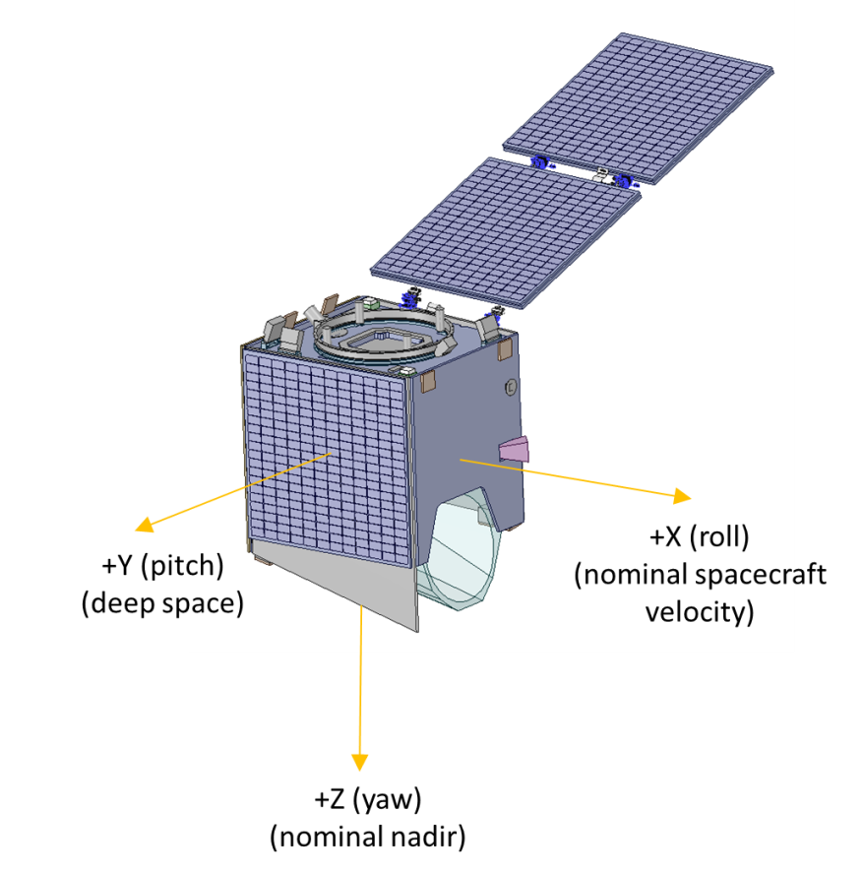
LOCUS as an example – extended SSTL-150
50 cm off axis Cassegrain
Receiver cooled to <100K
Mass ~ 265 kg
Payload 50 kg
Power ~ 190 W
© SSTL

Slide 49
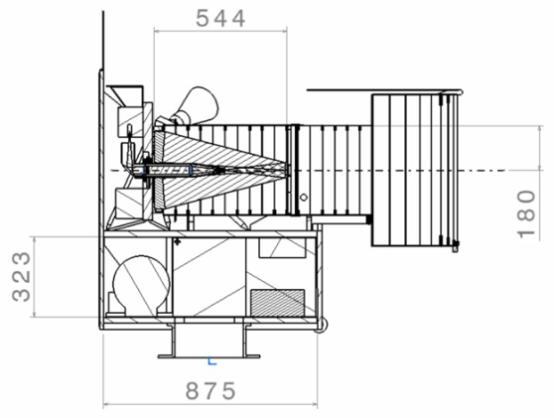
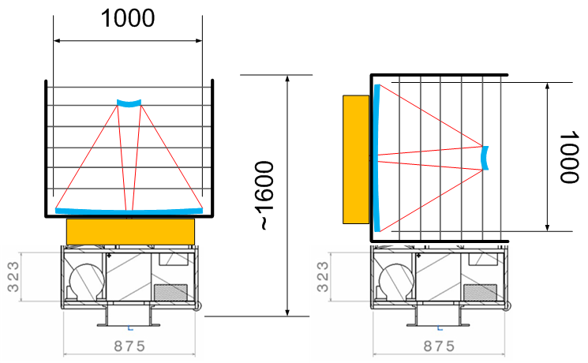
Alternative approach
Start from SSTL concept for CHEOPS
(35 cm optical telescope)
Mass (S/C+payload) ~ 200 kg
Take this “bus” and add 1m fast FIR telescope in tube
Mass ~250 kg (S/C + payload) assuming SiC mirror @25 kg/m²
Lighter weight CFRP telescope possible?
Notes:
Surrey Satelite Technology limited
Borrow concept of Cheops. Assume same bus and fast 1m FIR telescope FAST=low focal ratio -number telescope, can get away because we have big effective beams, aberations don’t matter
SiC: silicon carbide mirror : Herschel or Carbon Fiber Reinforced Polymers ?

Slide 50

Accommodation - Soyuz

Slide 51

Accommodation - Vega

Slide 52

Accommodation --March 2D

Slide 53
Mission
Orbit is proposed as sun synchronous
Viewing direction is anti-Earth
Solar panels constantly illuminated
Radiators constantly face deep space
Full survey in 6 months with multiple passes over sky “bins”
Followup targeted observations
Notes:
The orbit naturally scans 1 degree per day on the sky with (assuming 90 minute orbit) 16 passes/deg in a day giving ~225 arcsec strips.
This implies we will need 5 or 6 diffraction limited detectors in a strip (40 arcsec beam at 1.5 THz) but somewhat lower at 4.7 THz.
Perhaps its best to adopt uniform PSF throughout the channels say 80 arcsec, then we would need 2 -3 detectors.

Slide 54
Synergies with other facilities
and community interest

Slide 55
There is a considerable IR community on both
sides (ESA and CAS) that worked with Herschel
China has invested in an China-Chile ALMA centre
FIRSPEX will provide targets for ALMA followup
(ALMA has superb spatial resolution whereas
FIRSPEX can map large areas)
Europe (ESO) is a partner in the ALMA project

Slide 56

The Milky Way Imaging Scroll Painting (MWISP) project
PMO 13.7 m telescope , 3*3 array SSAR, OTF mode
110—115GHz，rms 0.5K ¹²CO, 0.3K ¹³CO and C¹⁸O @ 0.16 km/s @ 30’’ cell
First step Cover −10°≤ l≤ 250°,|b|≤ 5°, and some interesting regions，~2600 deg²
Total spectra ~ 1×10⁸
5- 8 years, since 2011/11
56
Notes:
A lot of synergies with PMO telescope
Superconducting Spectroscopic Array Receiver (SSAR) is a 3x3 pixel multi-beam receiver in the millimeter wave band, and its data output rate is about 25MByte/s. The equipment includes: nine 2SB superconducting SIS mixer, no tuning digital local oscillator, digital bias supply, independent IF and broadband high-resolution digital spectrum analyzer etc. The equipment can receive 18-channel spectrum signals from the universe at the same time. The 13.7-m telescope and SSAR may generate the large-scale survey information of the entire galactic plane from 12CO (J=1-0), 13CO (J=1-0) and C18O (J=1-0) three isotopic molecular lines.
首先我介绍一下银河画卷计划的大致情况。我们是利用青海13.7米望远镜及超导成像频谱仪，对北银道面银径在-10度至250度之间，银纬在正负5度之间，大约2600个平方度的天区范围，进行一氧化碳三种同位素分子的无偏观测，望远镜投入时间约为每年8个月，总计观测时间为5-8年，相关的科学研究会持续更长的时间。预计最终产出的总谱线数为10⁸条。
56

Slide 57

1,分子云的大尺度物理化学性质与分子云的演化
基于超过500平方度的观测数据，研究巨分子云的结构与演化；建立银河系分子云的丰度样本及梯度分布；研究原子云到分子云的转化-分子云的形成。
银河系分子气体：Planck卫星与Columbia大学1.2m毫米波望远镜巡天的结果
Planck Team, ESA
Notes:
Superconducting Spectroscopic Array Receiver (SSAR) is a 3x3 pixel multi-beam receiver in the millimeter wave band, and its data output rate is about 25MByte/s. The equipment includes: nine 2SB superconducting SIS mixer, no tuning digital local oscillator, digital bias supply, independent IF and broadband high-resolution digital spectrum analyzer etc. The equipment can receive 18-channel spectrum signals from the universe at the same time. The 13.7-m telescope and SSAR may generate the large-scale survey information of the entire galactic plane from 12CO (J=1-0), 13CO (J=1-0) and C18O (J=1-0) three isotopic molecular lines.

Slide 58
Conclusions
We propose the implementation of a high spectral resolution
Terahertz (THz) heterodyne receiver system for astronomical
research.
FIRSPEX will carry out the first ever `all sky’ spectroscopic
survey in five discreet bands providing unique 3-D maps of
the Galaxy.
FIRSPEX is a novel, highly integrated and power efficient
(60W) mission compatible with a small scale mission and a
low-cost envelope.
Most of the payload technology already TRL>7. Parts of the
Payload have been using in EO studies (e.g. LOCUS) and/or
Space (eg JUICE). The mission is ITAR-free.

Slide 59
Thank you
谢谢你

Slide 60
FIRSPEX : Where are we now?
Most of the payload technology already TRL>7
Development of enhanced supra-THz Schottky diodes – improved noise and lower LO power requirements.
  Development of sub-harmonic mixers for 1.9THz – 4th harmonic?
  QCL device development with low power dissipation, higher operational temperature, and frequency stability.
  Reduced power dissipation back-end spectrometers – ASICs.
  Improved cryogenics heat lift mostly for 4.7THz band
Some of the above topics are already being worked for EO (e.g. LOCUS)

